Slide 1
Unit-7
Searching and Hashing

Slide 2
What is Searching?
We know that today’s computer stores a lot of information.
To retrieve this information effectively we need very efficient searching algorithms.
Searching is an operation or a technique that helps to find the location of a given elements or value in the list or array.
Or
Searching refers to the operation of finding the location of given data item in a collection of items. It is the retrieval process from the sorted data
Any search is said to be successful or unsuccessful depending upon whether the element that is being searched is found or not.

Slide 3
In data structures,
There are several searching techniques like Linear Search, Binary Search, Tree Search etc.
In these techniques, time taken to search any particular element depends on the total number of elements.
Types of Searching Algorithm:
Sequential Search Algorithm
Binary Search Algorithm
Tree Search Algorithm

Slide 4
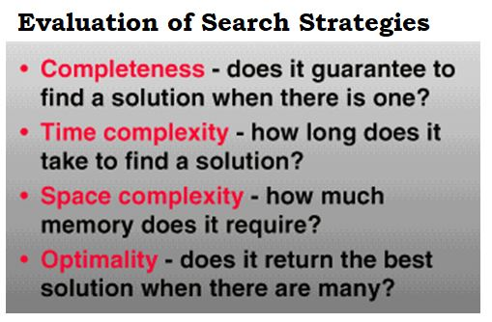
Drawback:
The main drawback of these techniques is:
As the number of elements increases, time taken to perform the search also increases.
This becomes problematic when total number of elements become too large.

Slide 5
1. Sequential search algorithm
It is also called linear search algorithm. It can be applied to array as well as linked list. This method is used for both sorted and unsorted data items.
Algorithm:
1. Read the target value to find in an array.
2. Set key=0
3. While (key<n) n is number of elements of array ‘a’.
{
if (a[key]==target)
Print the index of array i.e. key
Stop
else
key++
}
4. If data is not found, display the message.

Slide 6
//Method1: sequential search program using while loop with function. (seq1.cpp)
#include<stdio.h>
#include<conio.h>
int seq_search(int target,int a[], int n);
void main()
{
int i, n, target, pos, a[20];
clrscr();
printf("Enter the value of n:\n");
scanf("%d", &n);
for (i = 0; i < n; i++)
{
printf("%d. Enter a data:",i+1);
scanf("%d", &a[i]);
}
printf("Enter the data/item to be searched:");
scanf("%d", &target);
pos = seq_search(target, a, n);
if (pos<0)
printf("Search unscccessful");
else
printf("%d(i.e target data) is in %d poistion of array" ,target, pos);
getch();
}
int seq_search(int target,int a[], int n)
{
int key=0;
while(key<n)
{
if(a[key] == target)
return key;
else
key++;
}
}

Slide 7
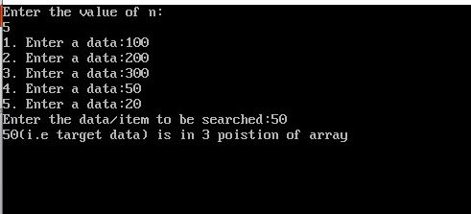

Slide 8
//Method2: sequential search program using for loop with function. (seq.cpp)
#include <stdio.h>
#include <conio.h>
int seq_search(int key, int a[], int n)
{
int i;
for (i = 0; i < n; i++)
{
if(a[i] == key)
return i+1;
}
return 0;
}
void main()
{
int i, n, key, pos, a[20];
clrscr();
printf("enter the total number of data you want to enter:\n");
scanf("%d", & n);
for (i = 0; i < n; i++)
{
printf("%d. Enter a data:",i+1);
scanf("%d", &a[i]);
}
printf("Enter the data/item to be searched:");
scanf("%d", &key);
pos = seq_search(key, a, n);
if (pos == 0)
printf("Search unscccessful");
else
printf("key found at position %d in the size of array %d", pos,n);
getch();
}

Slide 9
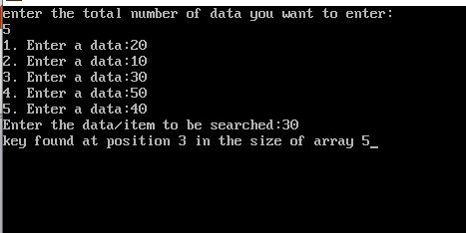

Slide 10
//METHOD 3: using only for loop no use of function. (Seq2.cpp)
void main()
{
int i, n, target, a[20], found=0;
printf("Enter how many data you want to enter:\n");
scanf("%d", &n);
printf("enter %d data:\n",n);
for (i = 0; i < n; i++)
{
scanf("%d", &a[i]);
}
printf("Enter the data/element to be searched:");
scanf("%d", &target);
for(i=0; i<n; i++)
{
if(a[i] == target)
{
printf("element found in index %d",i);
found=1;
break;
}
}
if(found==0)
printf("data not found in an array.");
getch();
}

Slide 11
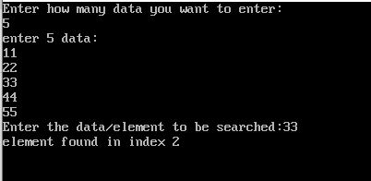
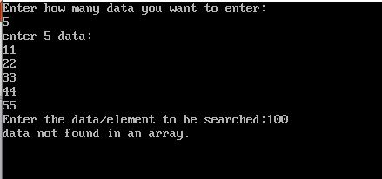

Slide 12
//METHOD 4 : using only for loop no use of function. (Seq3.cpp)
void main()
{
int i, n, target, a[20];
printf("Enter how many data you want to enter:\n");
scanf("%d", &n);
printf("enter %d data:\n",n);
for (i = 0; i < n; i++)
{
scanf("%d", &a[i]);
}
printf("Enter the data/element to be searched:");
scanf("%d", &target);
for(i=0; i<n; i++)
{
if(a[i] == target)
{
printf("element found in index %d",i);
break;
}
}
if(i==n)
printf("data not found in an array.");
getch();
}

Slide 13
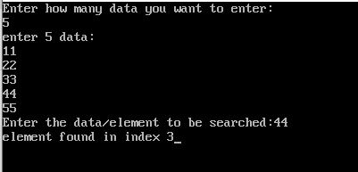

Slide 14
//METHOD 5: using only for loop no use of function. (Seq4.cpp)
void main()
{
int a[10],i,size,item,pos,found=0;
printf("Enter the size of an array:\n");
scanf("%d",&size);
printf("Enter the elements of the array:\n");
for(i=0;i<size;i++)
{
scanf("%d",&a[i]);
}
printf("Enter the element to be searched:");
scanf("%d",&item);
for(i=0;i<size;i++)
{
if(item==a[i])
{
pos=i;
flound=1;
break;
}
}
if(found==1)
printf("The position of %d in array is: %d",item, pos+1);
else
printf("The element is not found");
getch();
}

Slide 15
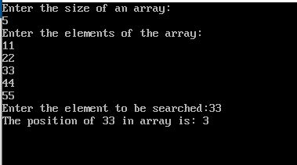
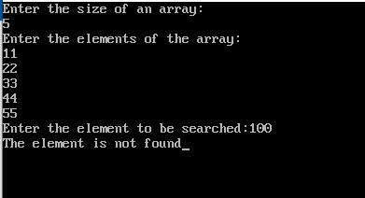

Slide 16
//METHOD 6: using only while loop no use of function. (Seq5.cpp)
void main()
{
int i, n, target, pos, key=0, a[20];
printf("Enter the value of n:\n");
scanf("%d", &n);
for (i = 0; i < n; i++)
{
printf("%d. Enter a data:",i+1);
scanf("%d", &a[i]);
}
printf("Enter the data/item to be searched:");
scanf("%d", &target);
while(key<n)
{
if(a[key] == target)
{
pos=key;
printf("%d is in %d position of array.",target, pos+1);
break;
}
else
key++;
}
if(key==n)
printf("%d is not in array",target);
getch();
}

Slide 17
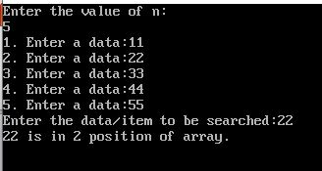
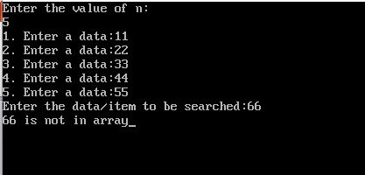

Slide 18
Time complexity of linear search:
If we have data in array as follows:
0 1 2 3 4 5 6 7
If we want to find data 14 then in one comparison we find data. So Best Case: O(1)
If we want to find data 76 then in N comparison needed. So Worse Case: O(n)
For Average Case: ∑all cases = 1+2+3+………+n
No. of cases n
= n(n+1) = (n+1)
2 . n 2
So Average Case: O(n+1)
2
14 | 44 | 55 | 33 | 21 | 88 | 9 | 76

Slide 19
2. Binary search algorithm:
The sequential search situation will be in worse case i.e. if the element is at the end of the list. For eliminating this problem one efficient searching technique called binary search is used in this case.
Binary search algorithm is types of searching algorithm which is very fast and efficient. To search using this method, the list of elements must be in sorted order.

Slide 20
In binary search, to search an element the comparison is made with element present in middle. If equal then the search is said to be successful otherwise the array is divided into two parts, one starting from 0 to (n/2-1) and the second portion from (n/2+1) to (n-1).
As a result, the first portion contains elements less than mid element and second portion contains element greater than mid element. If element to be search is smaller than mid element then searching will be continue in first portion, otherwise second portion, so, this process is repeated till element is found or division cannot be done further.

Slide 21
Algorithm:
1.Set top=no. of data-1 and bottom=0
2. While(bottom<=top)
{
Mid = (top+bottom)/2
if (key == a[mid]
return mid
if (key < a[mid] )
Top = mid-1
else
bottom = mid+1
}
3. If data is not found then display data not found message.

Slide 22
//binary search using function. (Binary1.cpp)
//method1:
#include<stdio.h>
#include<conio.h>
int binary_search(int n, int a[], int key);
void main()
{
int i, pos, n, key, a[100];
clrscr();
printf("Enter number of elements:\n");
scanf("%d", &n);
printf("Enter %d integers:\n", n);
for (i = 0; i < n; i++)
scanf("%d", &a[i]);
printf("Enter value to find:");
scanf("%d", &key);
pos=binary_search(n, a, key);
if(pos>=0)
printf("%d is location of data in array.",pos);
else
printf("%d in not present in list",key);
getch();
}
int binary_search(int n, int a[], int key)
{
int bottom=0, mid;
int top=n-1;
while (bottom <= top)
{
mid=(top+bottom)/2;
if(key==a[mid])
return mid;
if (key< a[mid])
top=mid-1;
else
bottom=mid+1;
}
return -1;
}

Slide 23
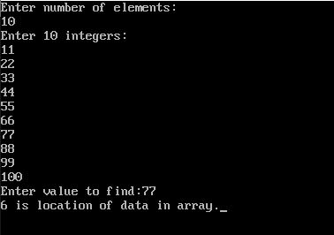
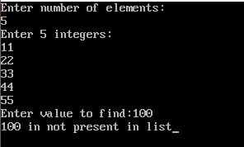
Output 1
Output 2

Slide 24
//binary search program without using function. (Binary.cpp) [ method2: ]
#include <stdio.h>
#include <conio.h>
int main()
{
int i, bottom=0, n, top=n-1, mid, flag, key, a[100];
clrscr();
printf("Enter number of elements:\n");
scanf("%d", &n);
printf("Enter %d integers in ascending order:\n", n);
for (i = 0; i < n; i++)
scanf("%d", &a[i]);
printf("Enter the element to be searched:");
scanf("%d", &key);
bottom=0;
top=n-1;
while (bottom <=top)
{
mid=(top+bottom)/2;
if(key==a[mid])
{
flag=1;
break;
}
else
{
if (key< a[mid])
top=mid-1;
else
bottom=mid+1;
}
}
if(flag==1)
printf("data found at location: %d",mid+1);
else
printf("%d is not present in the list.", key);
getch();
return 0;
}

Slide 25
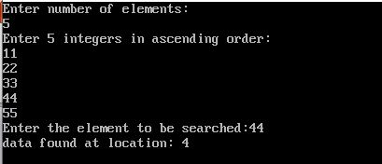
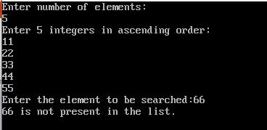
Output 1
Output 2

Slide 26
Time complexity of binary search:
Worst Case: O(log n)
Best Case: O(1)
Average Case: O(log n)

Slide 27
3. Tree search algorithm
The tree search algorithm is accomplished by two ways:
1. General search tree algorithm:
For general search tree algorithm, every node is traversed until the desired data item is found. The traversed may be in-order, preorder or post-order.
2. Binary search tree algorithm:
In binary search tree algorithm, first comparison is made with root node and accordingly either left sub-tree or right sub-tree is traversed for successful search.

Slide 28
Algorithm for binary search tree:
Read the target value.
Compare the target value with the root node.
If equal then, display the data found message.
else
If the target is less than root node, traversed to the left sub-tree else traversed right sub-tree.
5. Repeat step 2 and 3 until data is found or traverse is over.
6. stop

Slide 29
Hashing:
Hashing is a technique or process of mapping keys or values into the hash table by using a hash function.
It is done for faster access to elements.
In data structures, Hashing is a well-known technique to search any particular element among several elements.
It minimizes the number of comparison while performing the search.

Slide 30
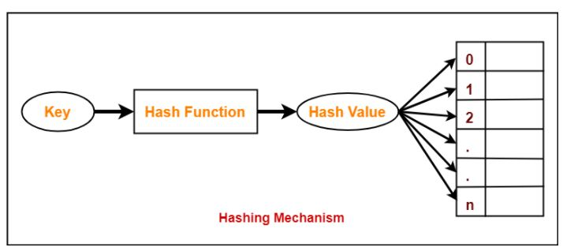
Hash Table

Slide 31
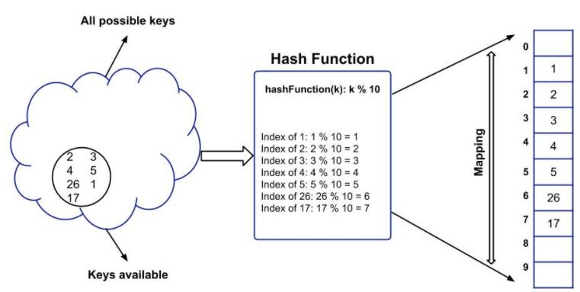
Hashing Mechanism

Slide 32
Hash table:
The table used for storage a key is called hash table.
Or
An array data structure called as Hash table is used to store the data items.
Hash Key Value:
Based on the hash key value, data items are inserted into the hash table.
Hash key value is a special value that serves as an index for a data item.
It indicates where the data item should be stored in the hash table.
Hash key value is generated using a hash function.

Slide 33
Hash function:
A hash function ‘H’ is simply a mathematical formula that manipulates the key in some form to compute the index of keys in hash table.
Or
Hash function is a mathematical function which is used to compute the hash value for a key.
So, the function that transforms a key into table index is called hash function.
Let a hash function H(x) maps the value at the index x%10 in an Array. For example if the list of values is [11,12,13,14,15] it will be stored at positions {1,2,3,4,5} in the array or Hash table respectively.

Slide 34
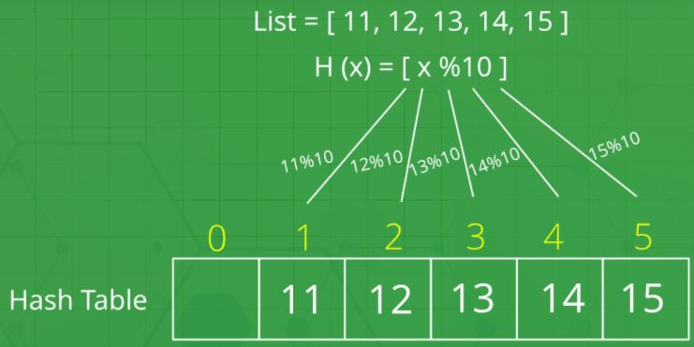
Keys
Hash Function
Hash Key Value

Slide 35
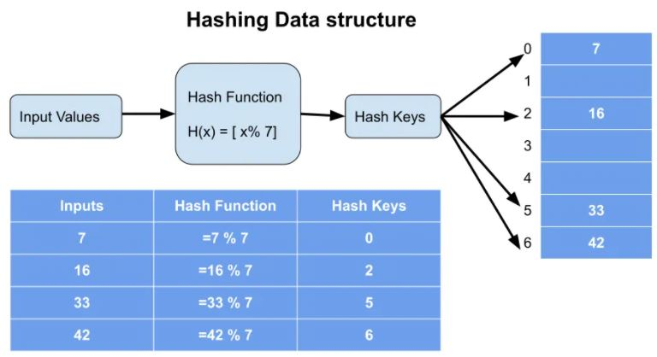

Slide 36
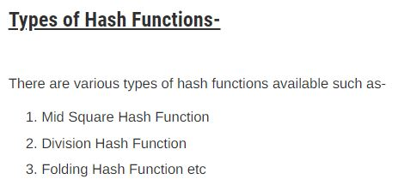
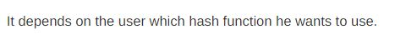
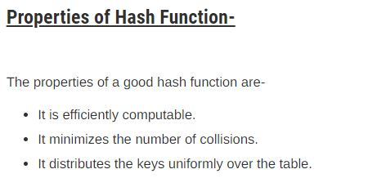

Slide 37
Advantages of Hashing:
Unlike other searching techniques,
Hashing is extremely efficient.
The time taken by it to perform the search does not depend upon the total number of elements.
It completes the search with constant time complexity O(1).

Slide 38
Collision in Hashing/ Hash Collision:
If hash function produces same index or slots for different data than hash collision occurs.
So, a Collision is a phenomenon that occurs when more than one key maps to the same slots in the hash table.
Or
When the hash value of a key maps to an already occupied bucket of the hash table, it is called as a Collision.

Slide 39
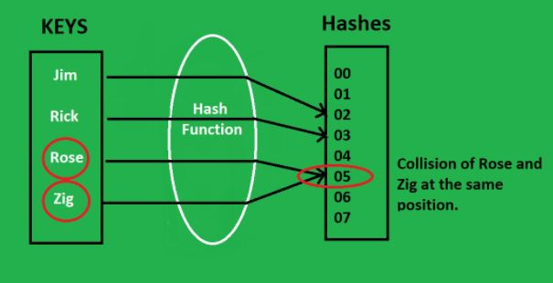
Fig: Collision in Hashing
Note: https://www.gatevidyalay.com/collision-resolution-techniques-separate-chaining/

Slide 40
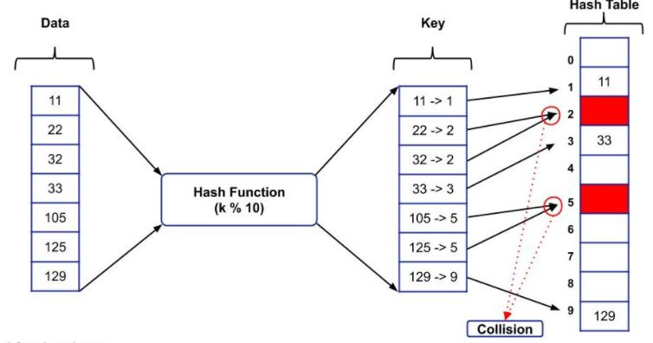
Fig: Collision in Hashing

Slide 41
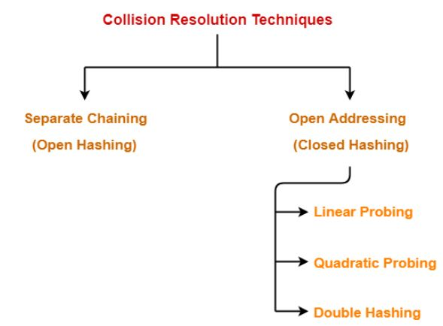
Collision Resolution Techniques:
Collision Resolution Techniques are the techniques used for resolving or handling the collision.
Collision resolution techniques are classified as:

Slide 42
Separate Chaining:
Chaining is a collision resolution technique where we make use of the linked list or list data structure to store the keys that are having the same value.
Question 1:
If the data/key is 3, 23, 24, 26, 36, 78, and 99, and the hash Function(k): k % 10 then store the key using separate chaining method.
Solution:
The hash function(k)=k%10

Slide 43
And the key is as follows:
3, 23, 24, 26, 36, 78, and 99
Now using hash function we get,
3%10=3
23%10=3
24%10=4
26%10=6
36%10=6
78%10=8
99%10=9

Slide 44
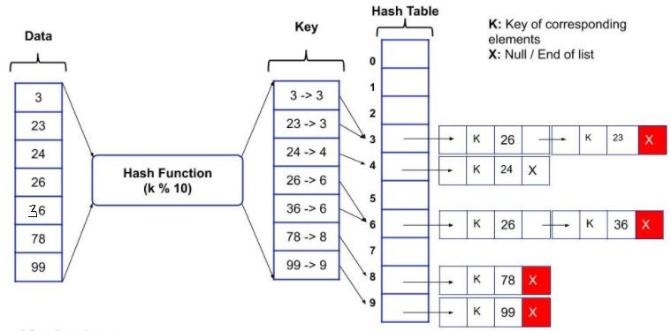
So, the storage of the data/key in the hash table can be represented as:

Slide 45
Question2:
Let us consider a simple hash function as “key mod 7” and sequence of keys as 50, 700, 76, 85, 92, 73, 101. now store the key using separate chaining method.
Solution:
Given hash function is key mod 7.

Slide 46
Sequence of keys is as follows:
50, 700, 76, 85, 92, 73, 101.
Now using hash function we get,
50%7=1
700%7=0
76%7=6
85%7=1
92%7=1
73%7=3
101%7=3
So, the storage of the data/key in the hash table can be represented as:

Slide 47
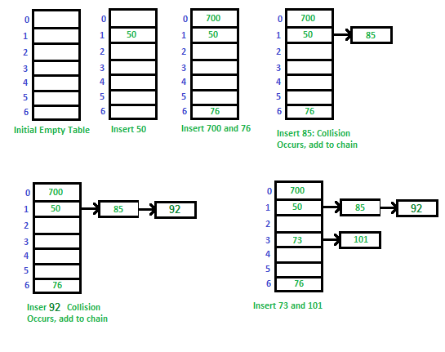

Slide 48
Advantages of Separate Chaining:
Simple to implement.
Hash table never fills up, we can always add more elements to the chain.
It is mostly used when it is unknown how many and how frequently keys may be inserted or deleted.
Disadvantages of Separate Chaining:
Wastage of Space (some index of hash table are never used)
If the chain becomes long, then search time can become O(n) in the worst case.
Uses extra space for links.
Note: https://www.geeksforgeeks.org/hashing-set-2-separate-chaining/

Slide 49
Open Addressing
Like separate chaining, open addressing is a method for handling collisions.
In Open Addressing, all elements are stored in the hash table itself. So at any point, the size of the table must be greater than or equal to the total number of keys.
Open Addressing is done in the following ways:
Linear Probing
Quadratic Probing
Double Hashing

Slide 50
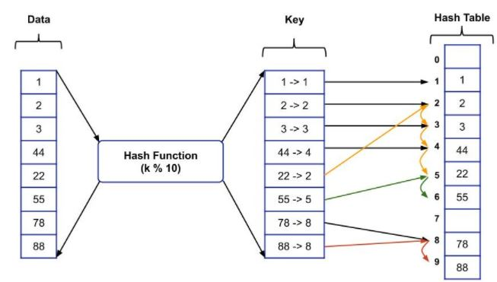

Slide 51
1. Linear Probing
In linear probing,
When collision occurs, we linearly probe for the next bucket.
We keep probing until an empty bucket is found.
The purpose of examining the slot in hash table is called probing or rehashing.
Linear probing uses the following hash function
h(k , i) = [ h’(k) + i ] mod m for i=0,1,2,3,4,…………….,m-1 where, m is size of hash table h’(k) = k mod m i is prob no.

Slide 52
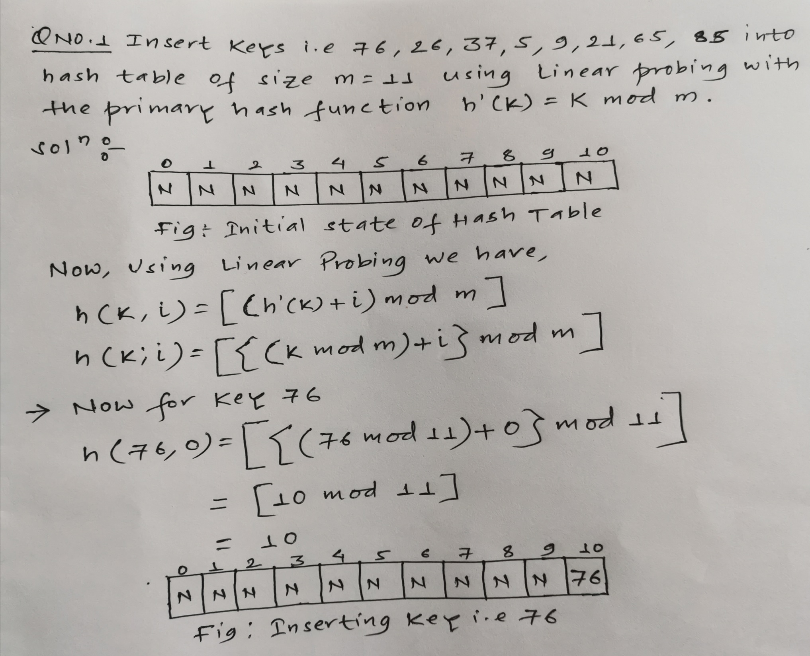

Slide 53
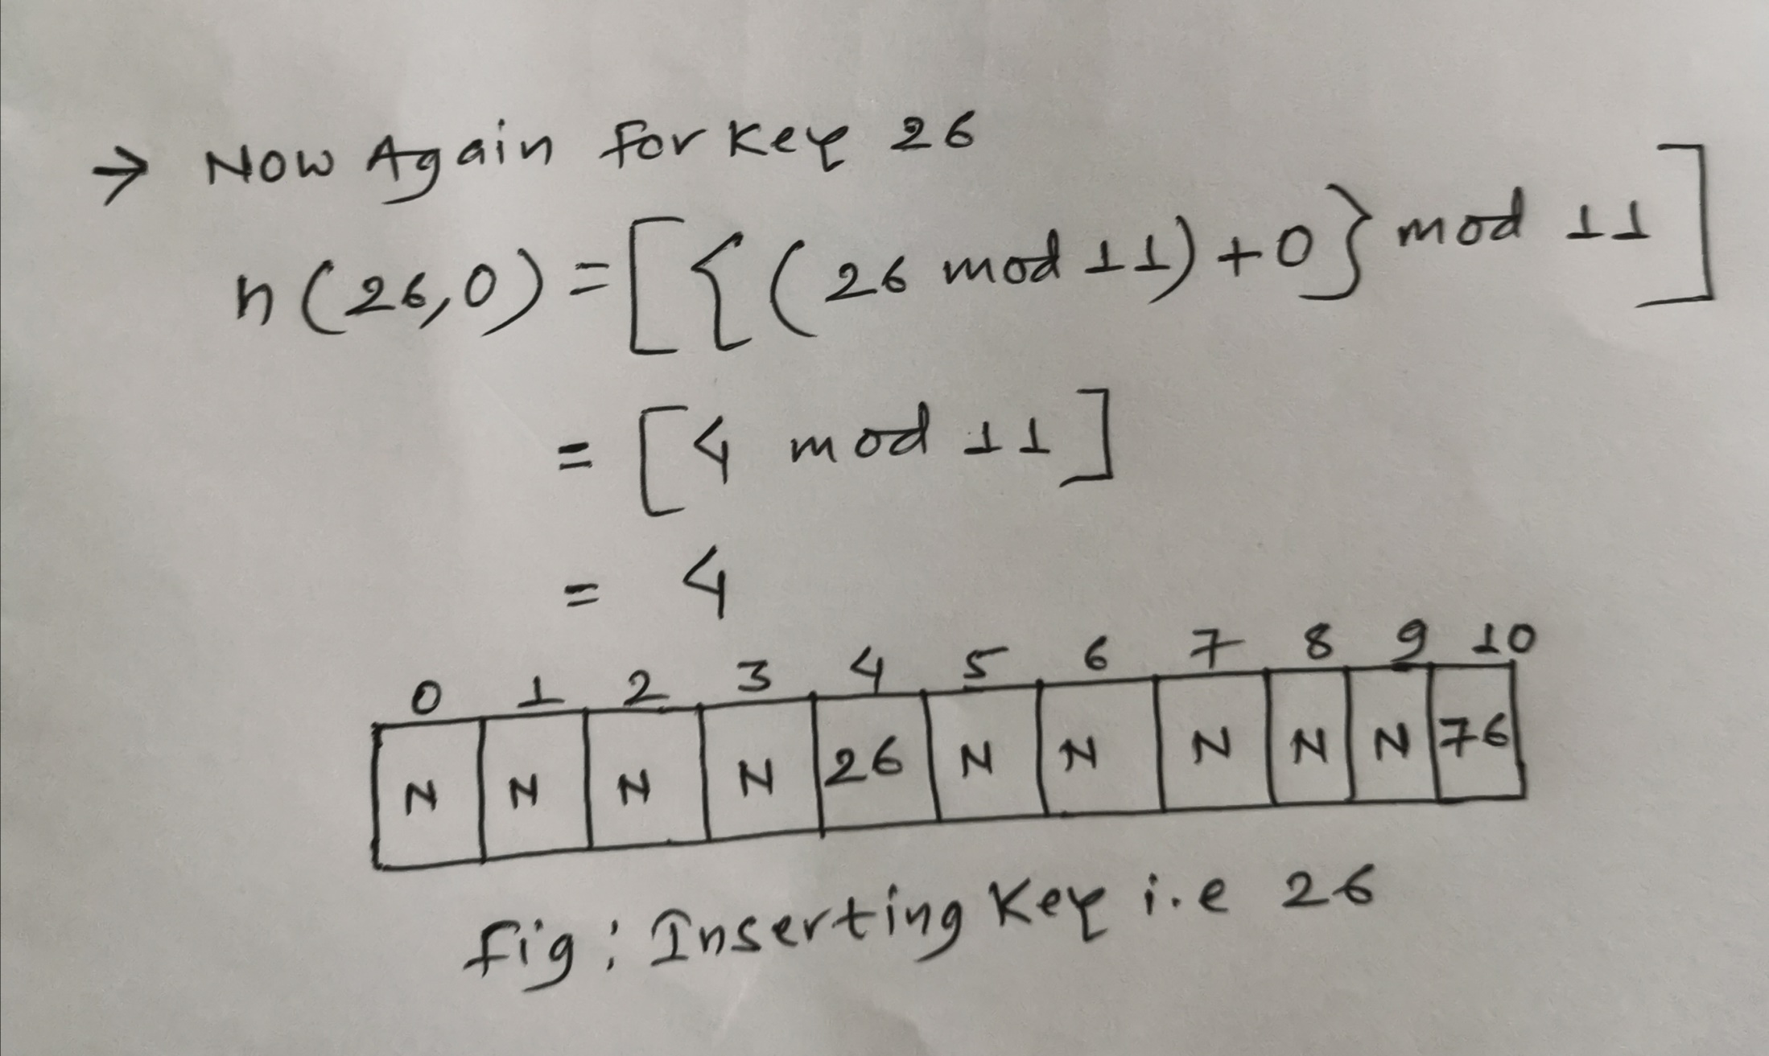

Slide 54
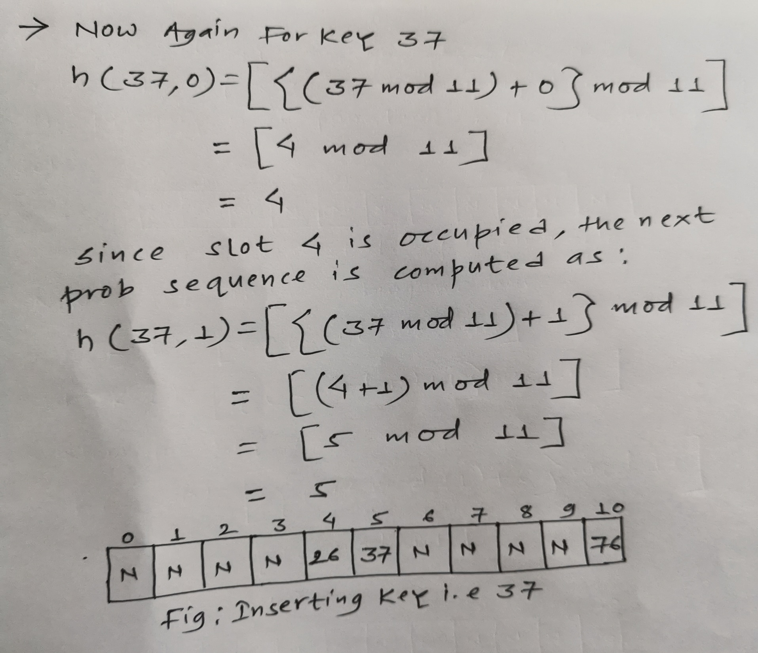

Slide 55
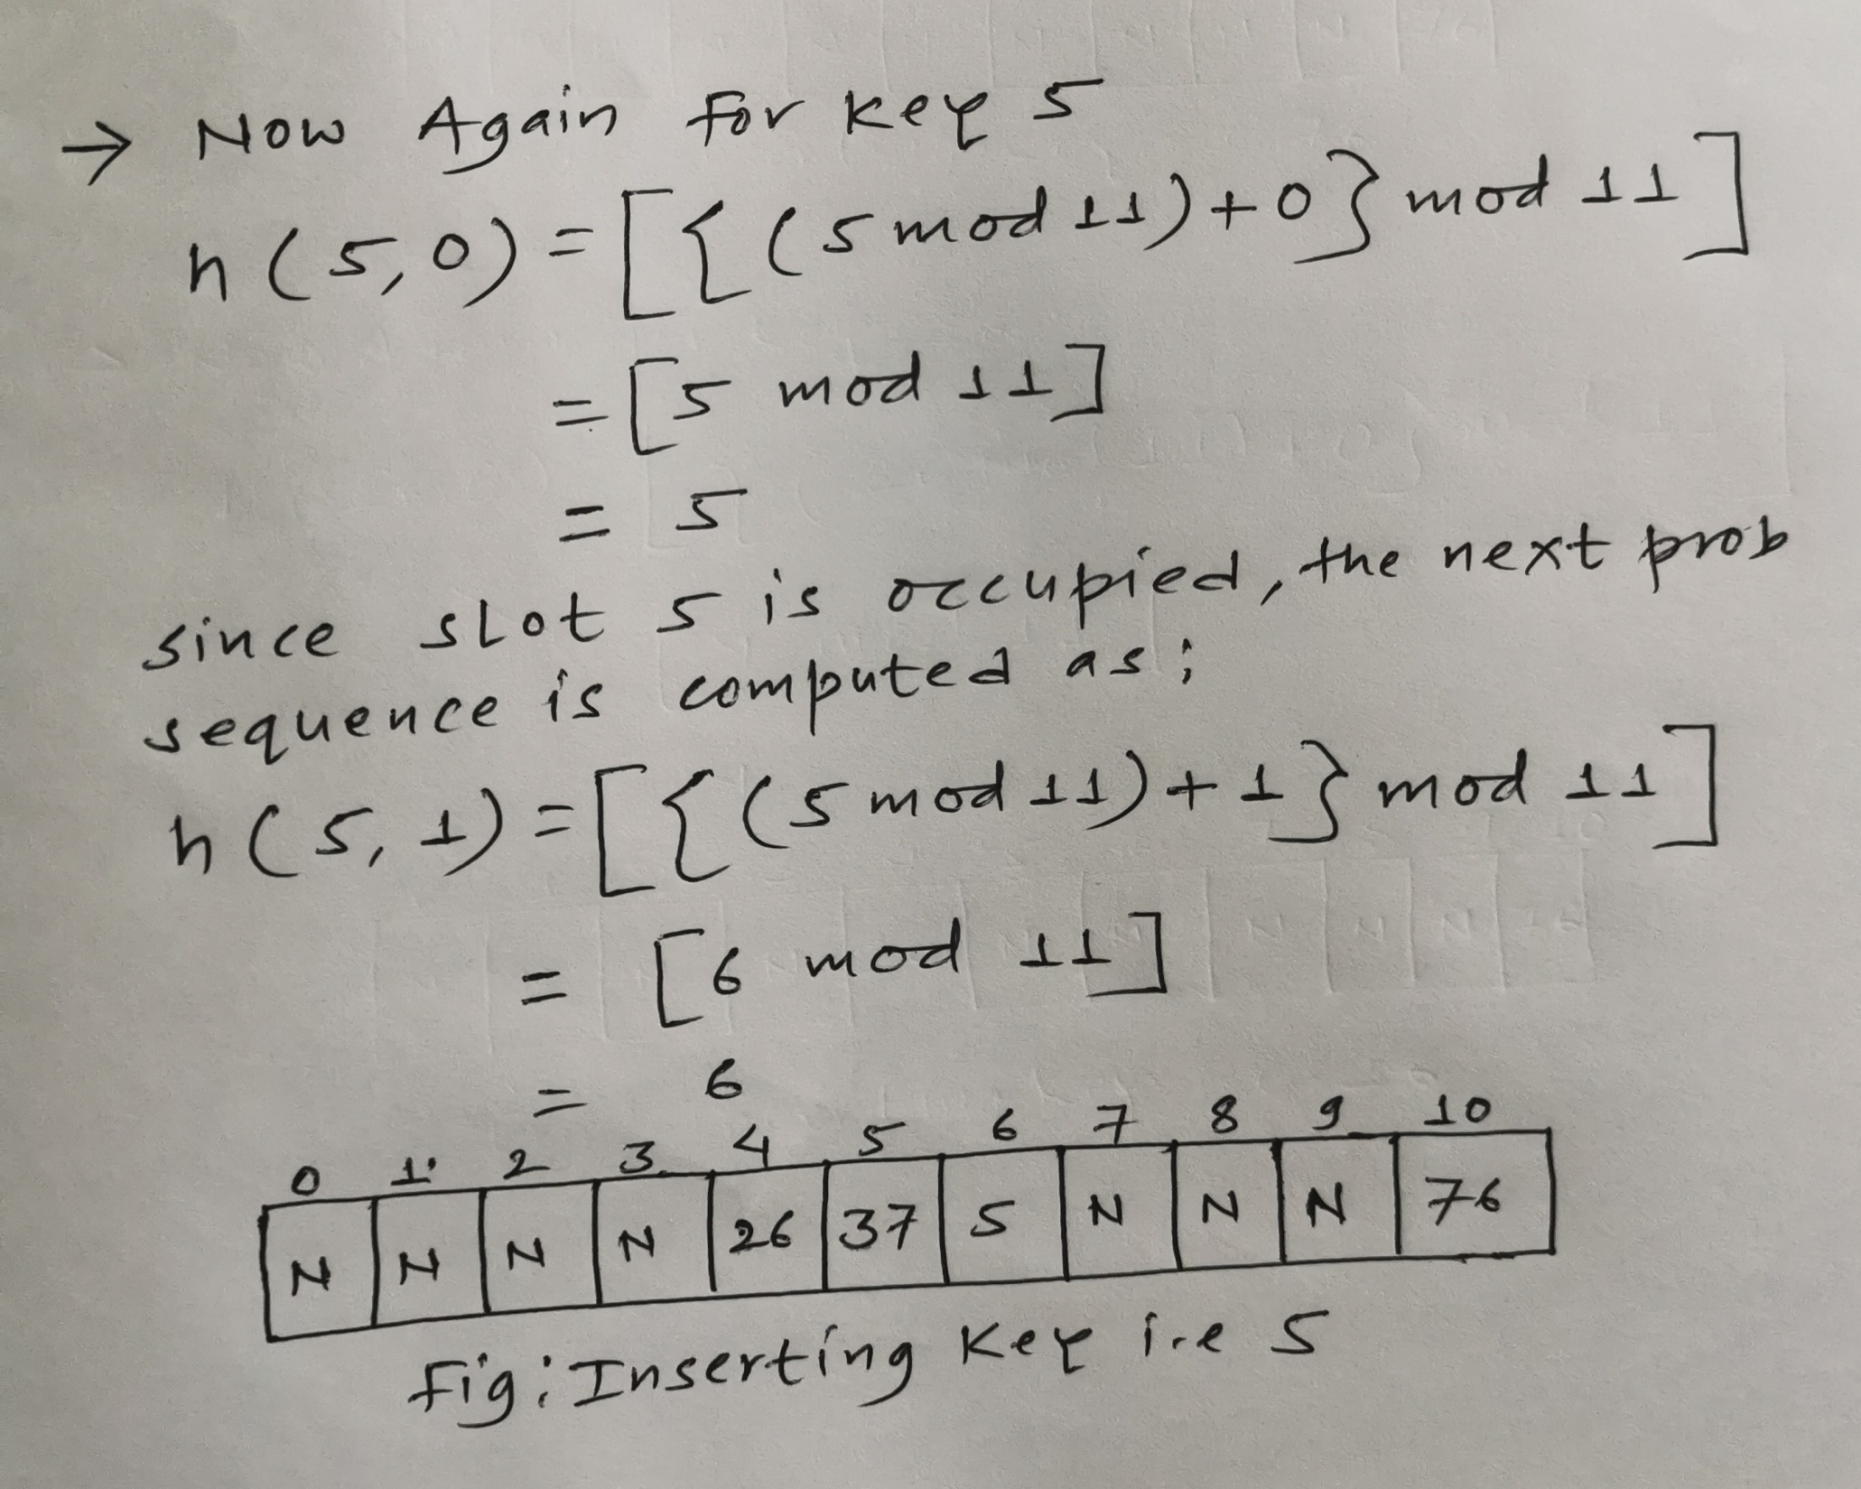

Slide 56
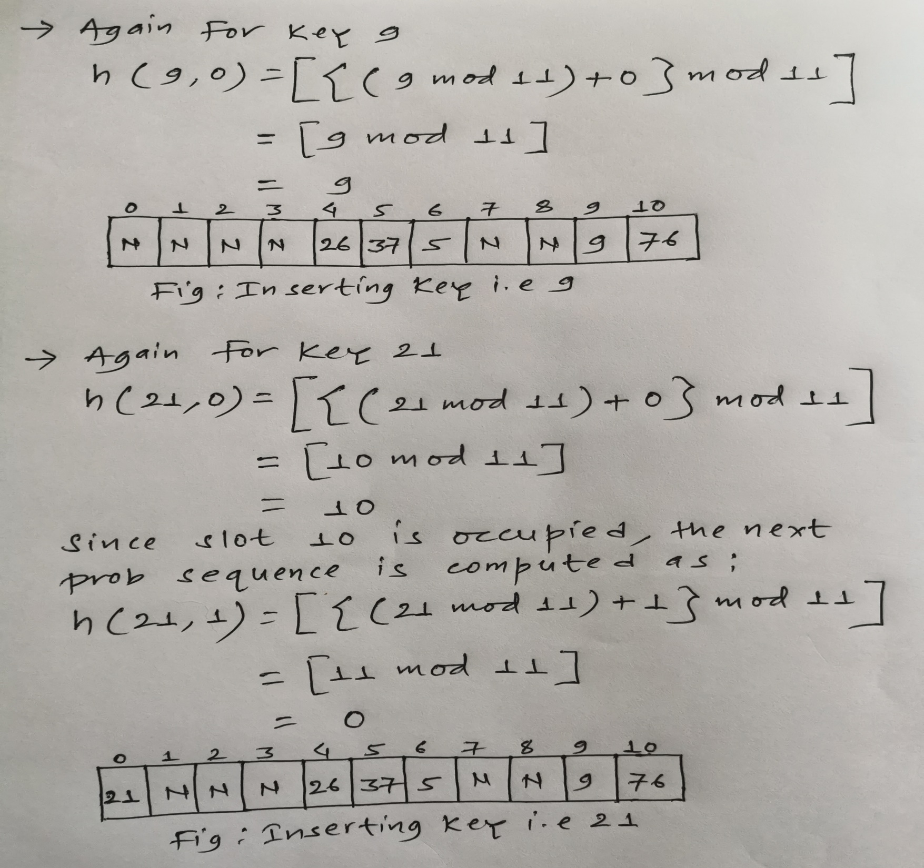

Slide 57
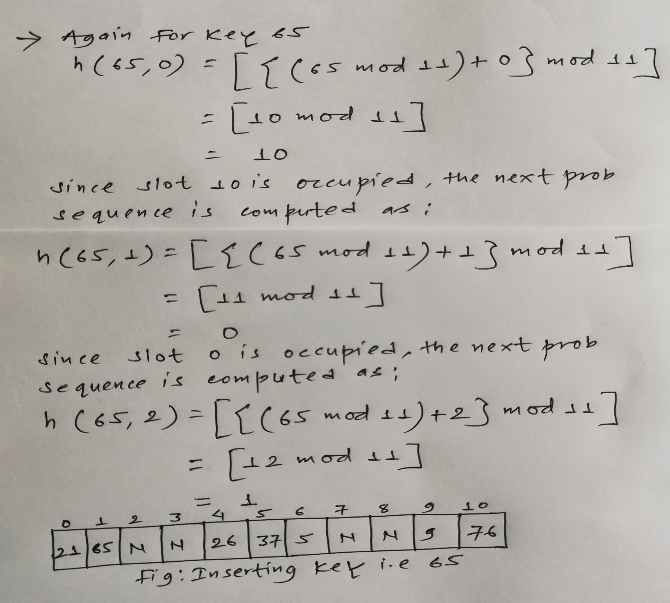

Slide 58
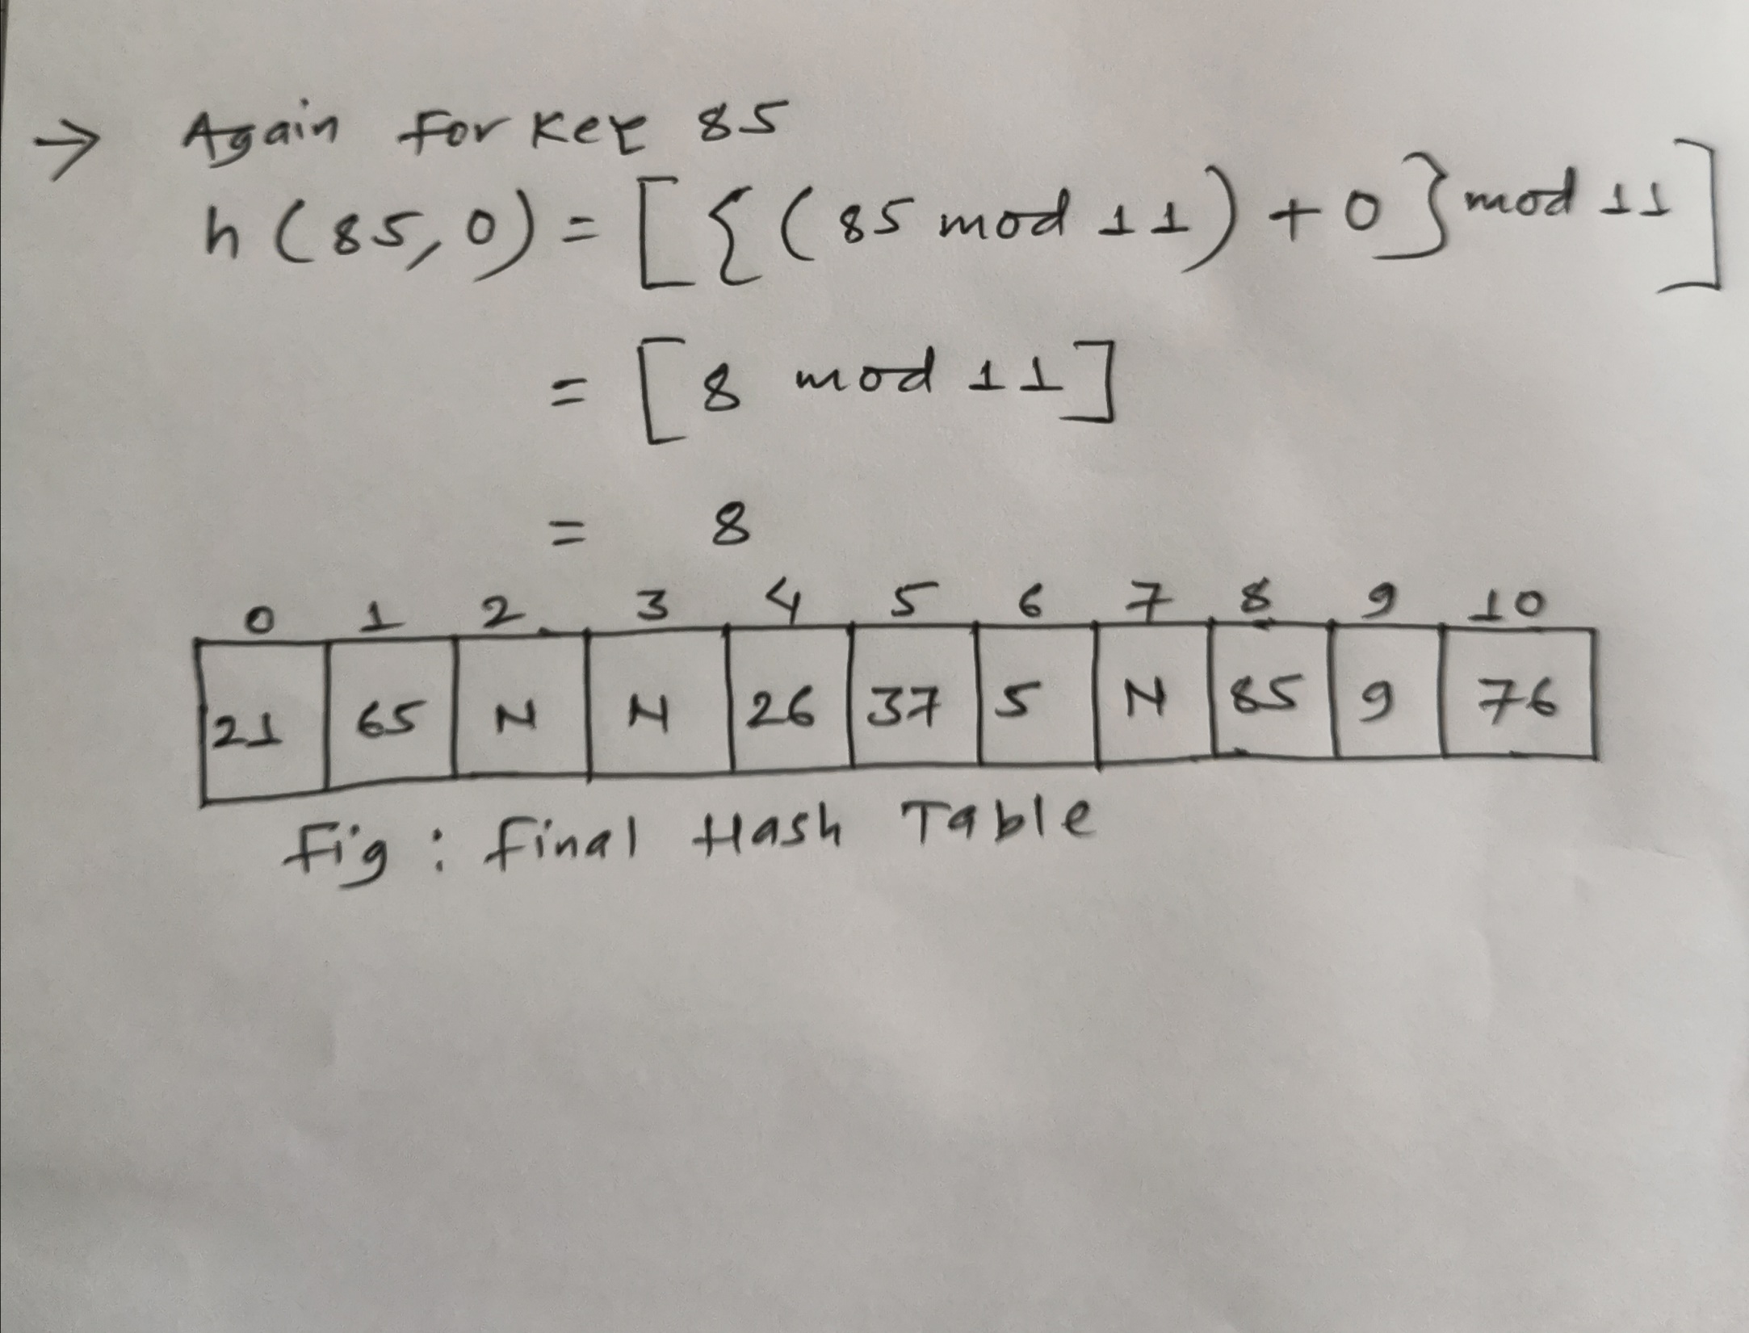

Slide 59
Q2. Let us consider a hash function h’(k)=k mod m where m=7 and sequence of keys as 50, 700, 76, 85, 92, 73, 101. Now store the keys using linear probing method.
Solution:

Slide 60
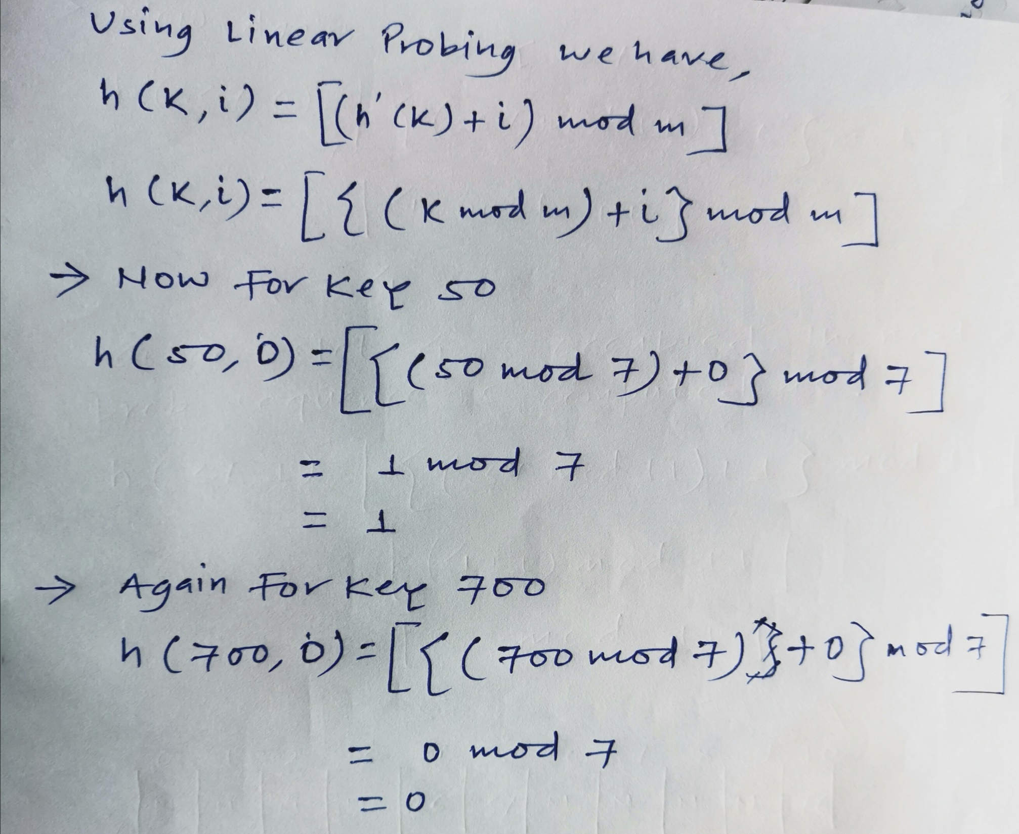

Slide 61
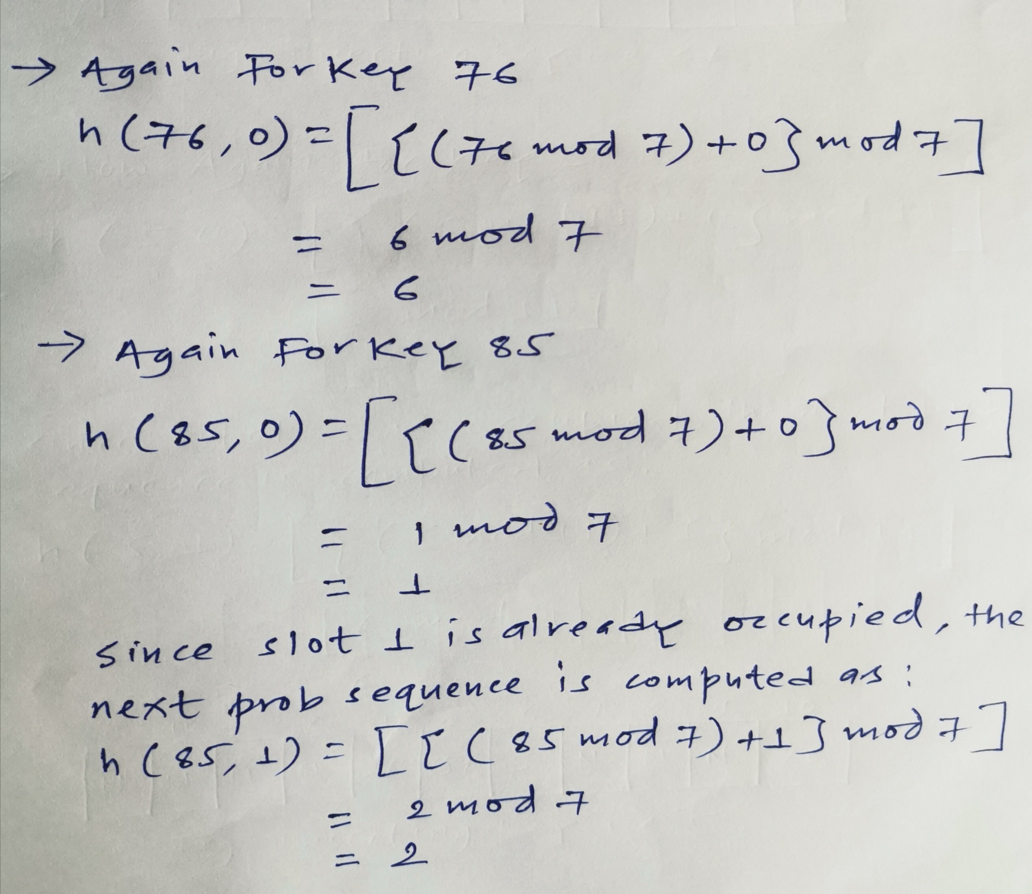

Slide 62
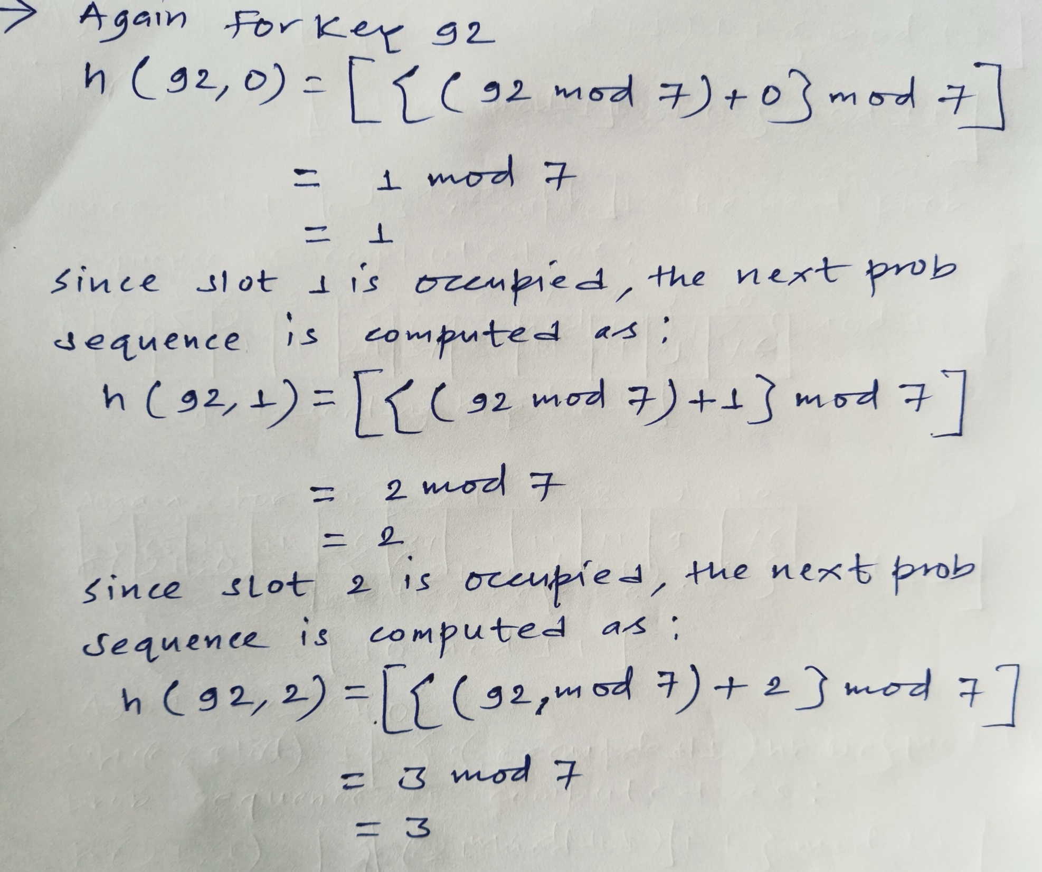

Slide 63
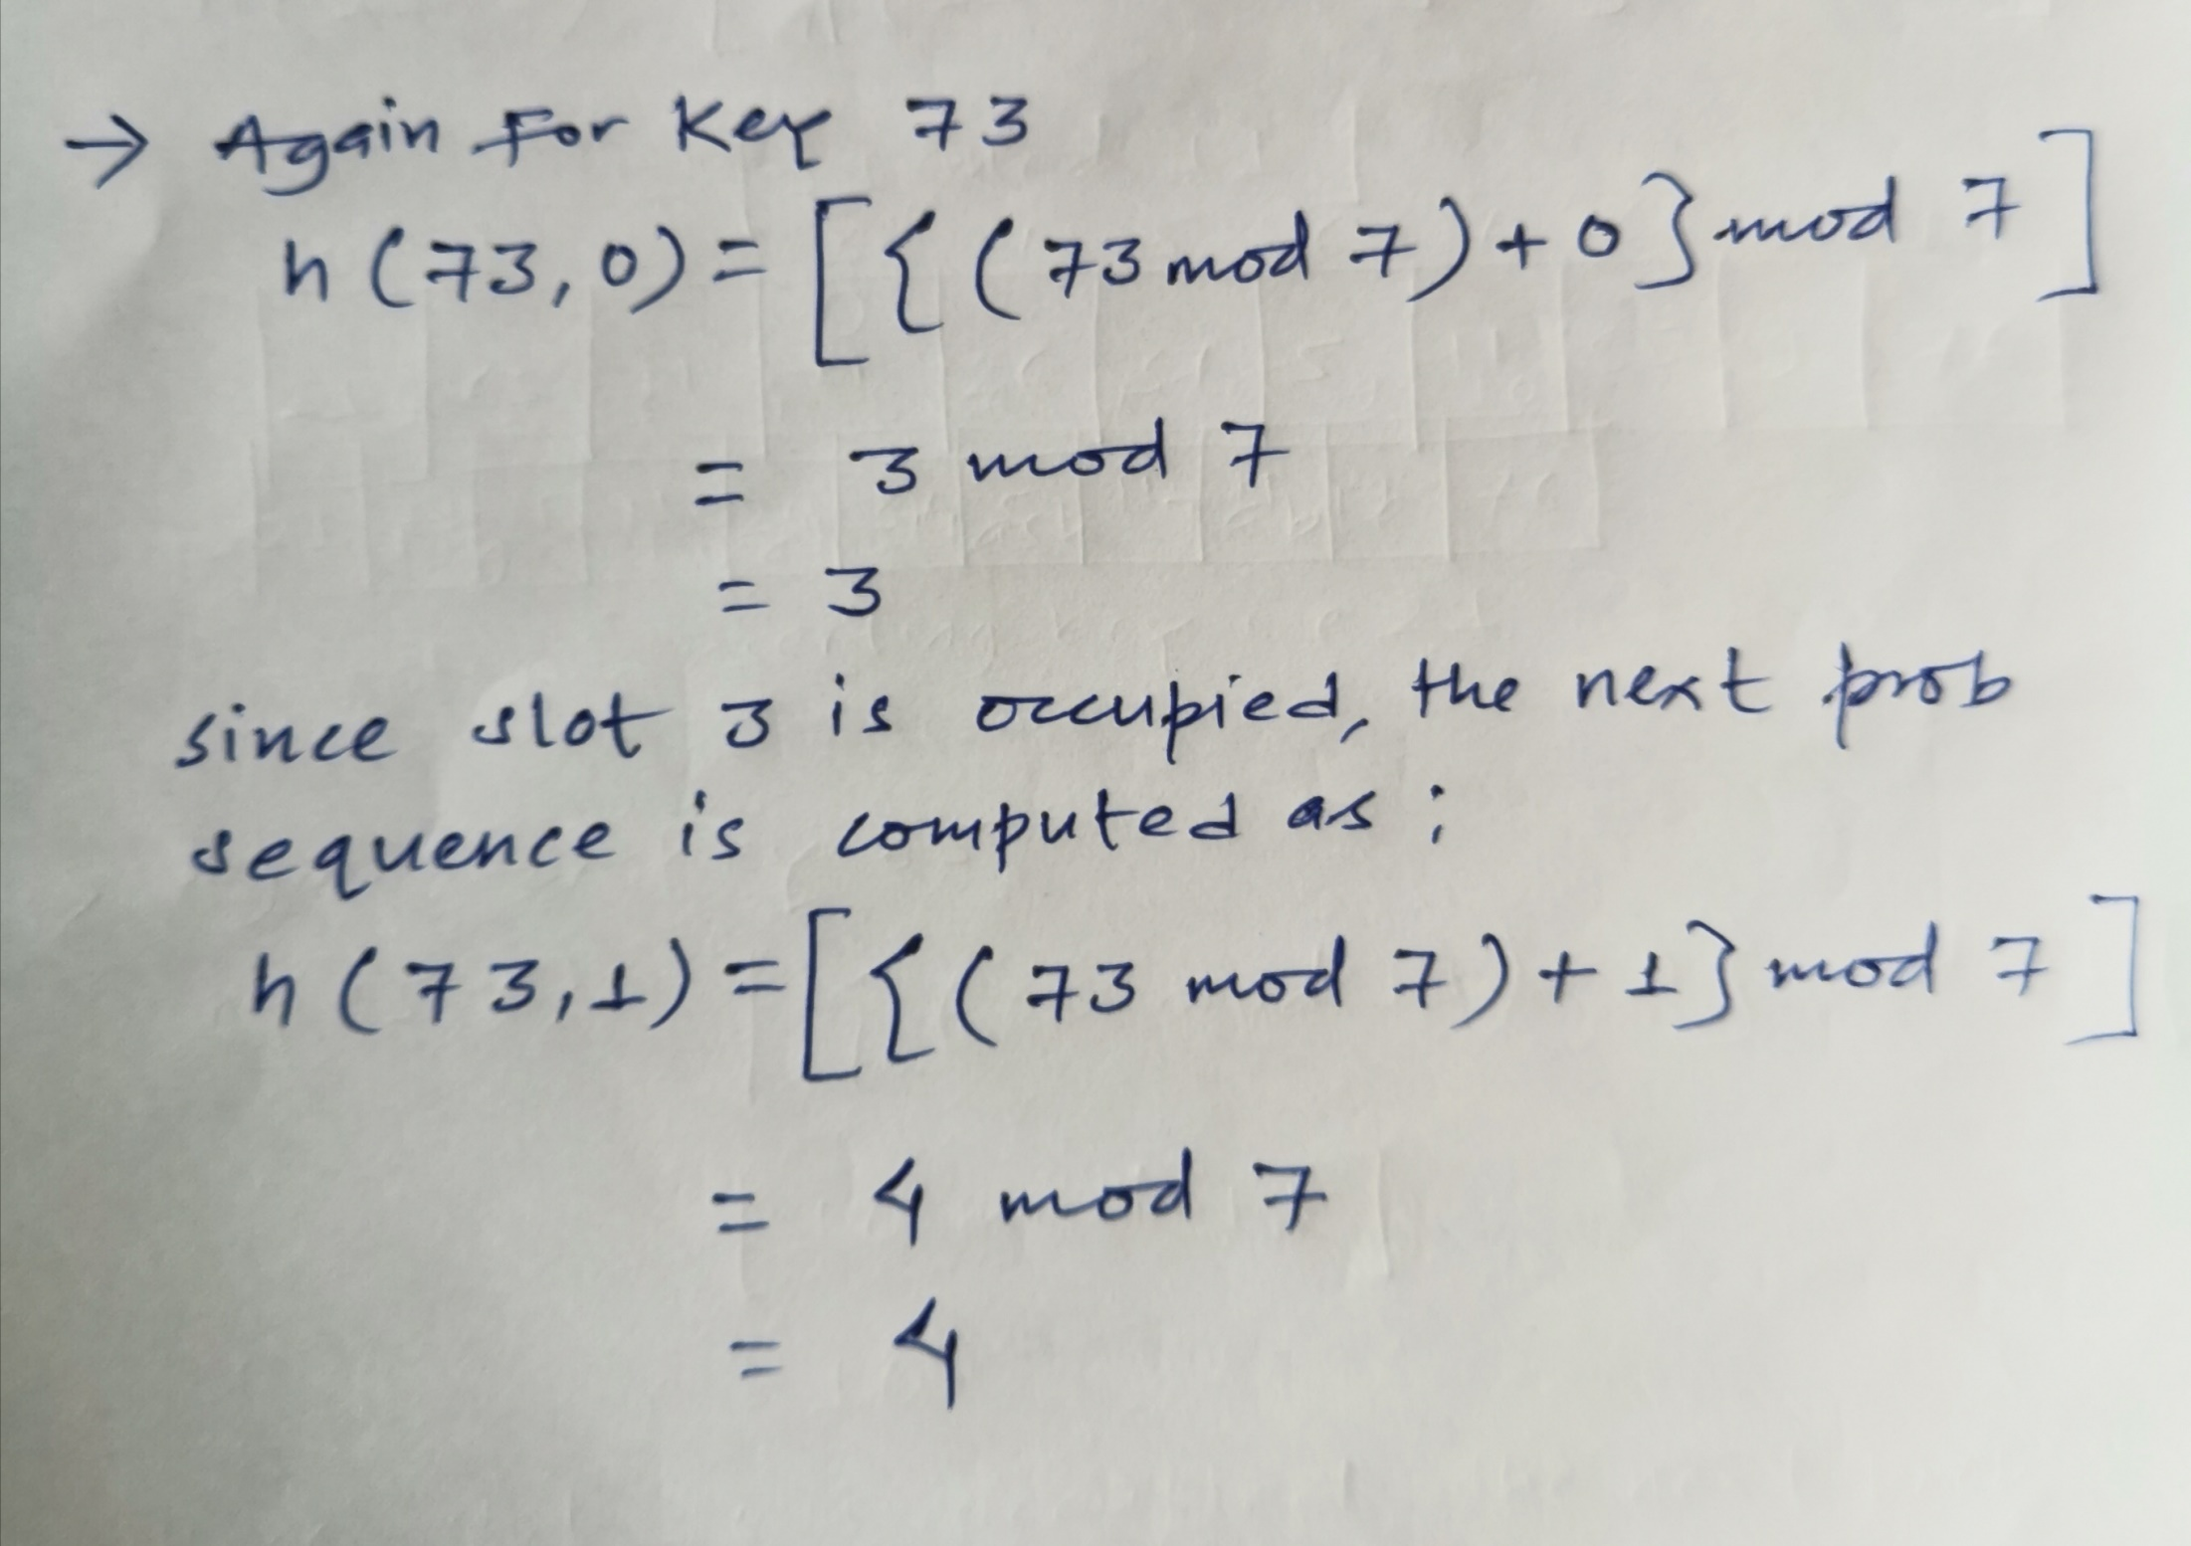

Slide 64
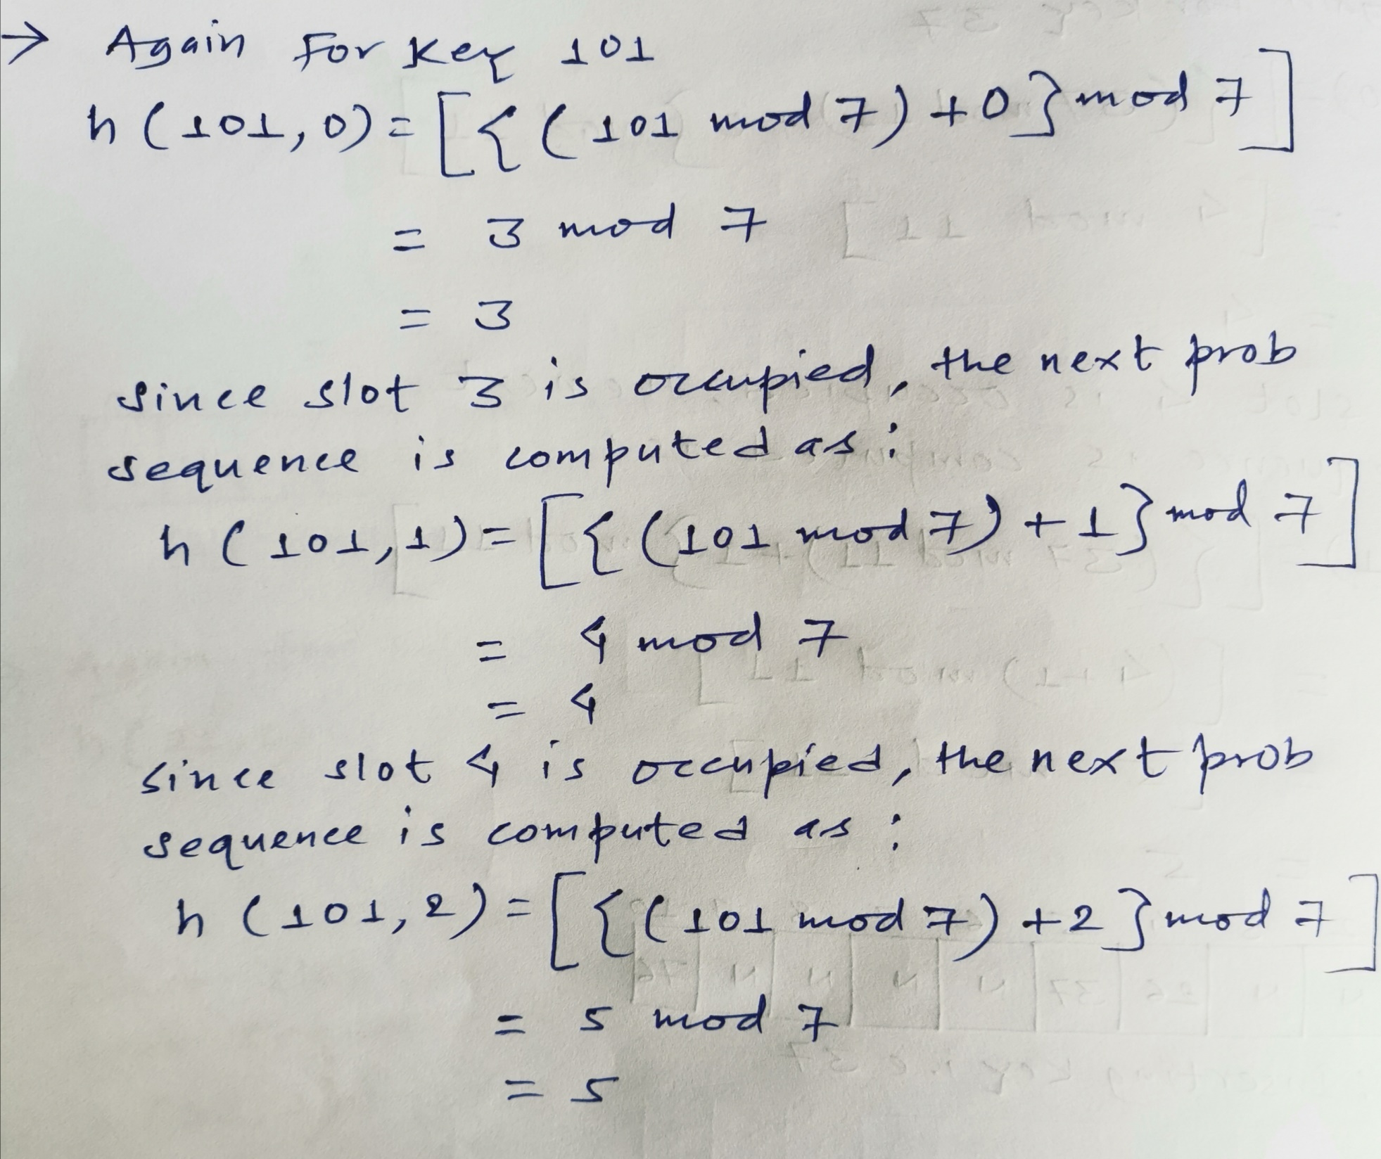

Slide 65
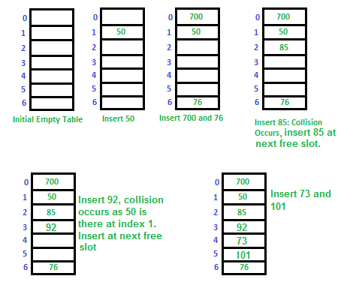
So, the storage of the data/key in the hash table can be represented as:

Slide 66
Advantage
It is easy to compute.
Disadvantage
It takes time to search an element or to find an empty bucket.
Primary Clustering: One of the problems with linear probing is Primary clustering, many consecutive elements form groups and it starts taking time to find a free slot or to search for an element.

Slide 67
2. Quadratic Probing:
In quadratic probing,
When collision occurs, we probe for i²th bucket in i^{th} iteration.
We keep probing until an empty bucket is found.
To avoid the problem of primary clustering quadratic probing is used with following hash function.
h( k, i) = [ h’(k)+ c₁ i + c₂ i² ] mod m for i = 0,1,2,3,4…………….,m-1 where m is size of hash table h’(k)=k mod m is basic hash function i is prob no. c1 and c2 is constant

Slide 68
Q1. Insert keys i.e. 76, 26, 37, 5, 9, 21, 65, 85 into hash table of size m=11 using quadratic probing with the primary hash function h’(k)=k mod m and c1=1 and c2=3 respectively.
Solution:

Slide 69
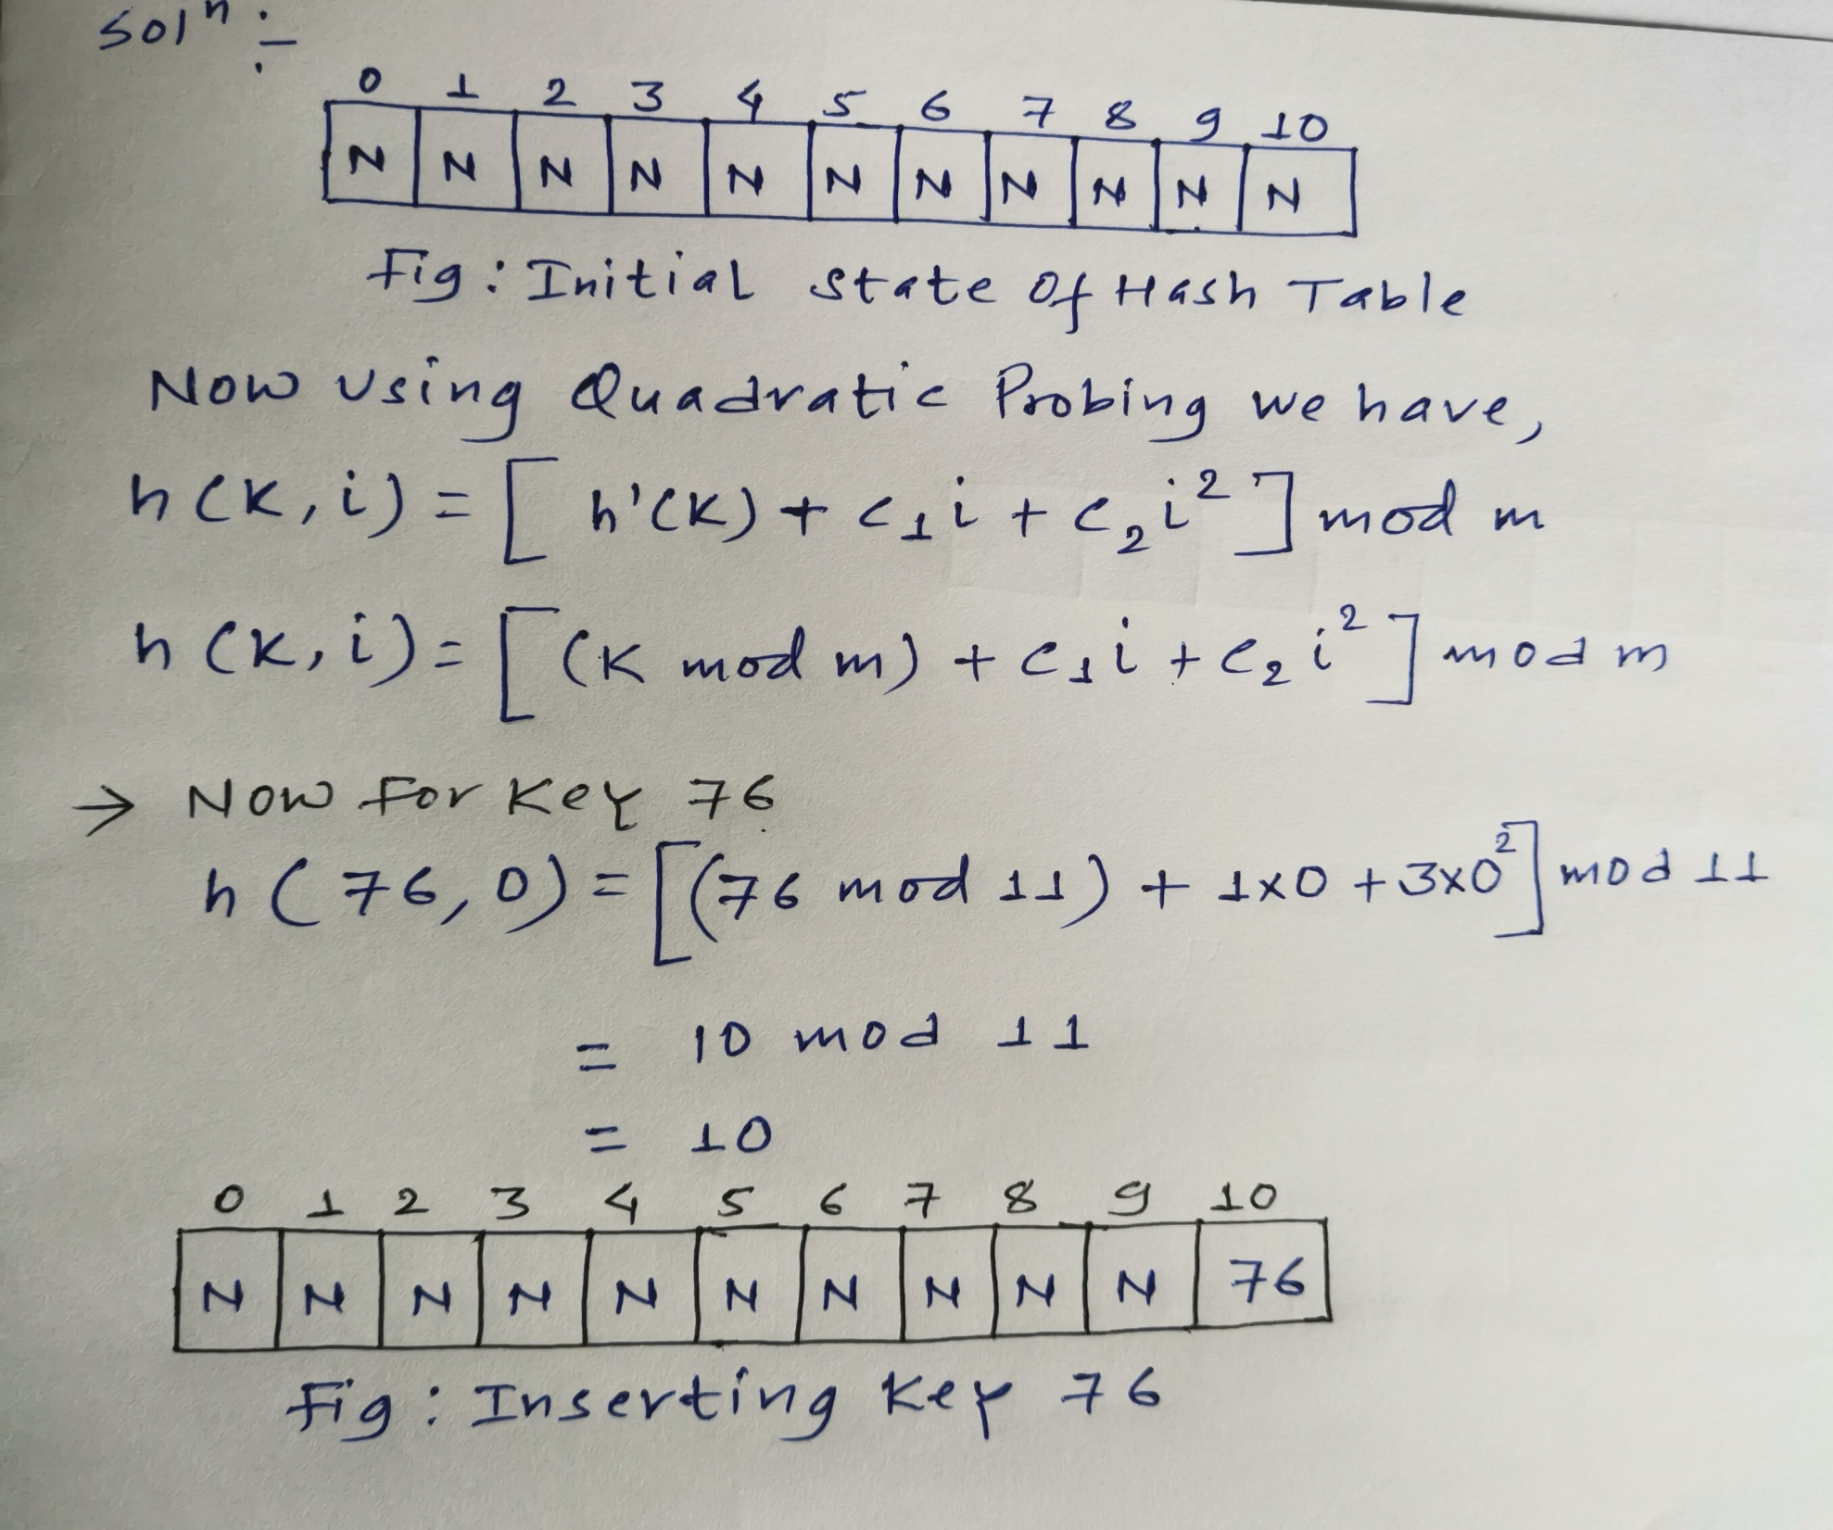

Slide 70
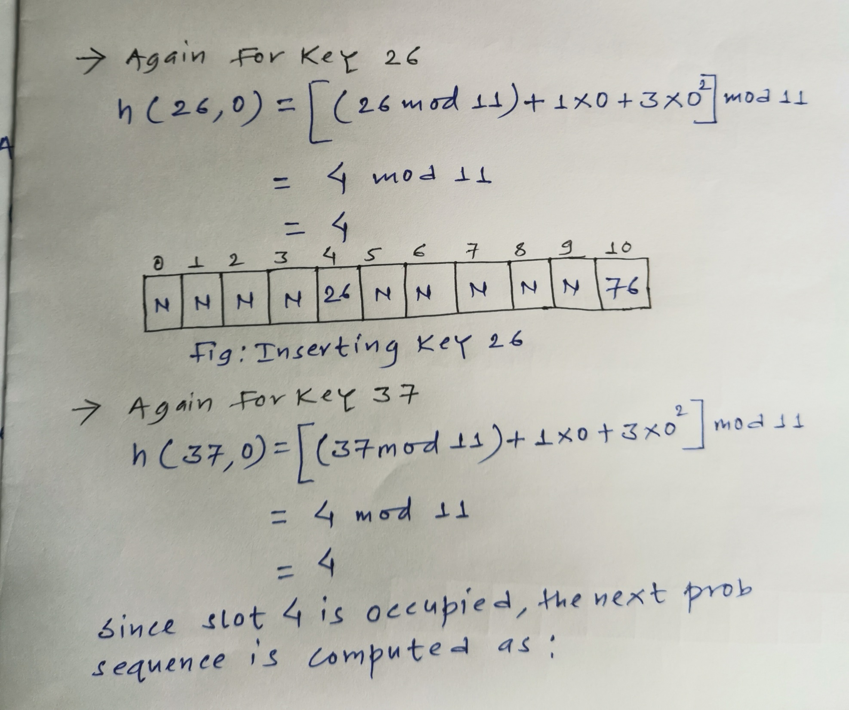

Slide 71
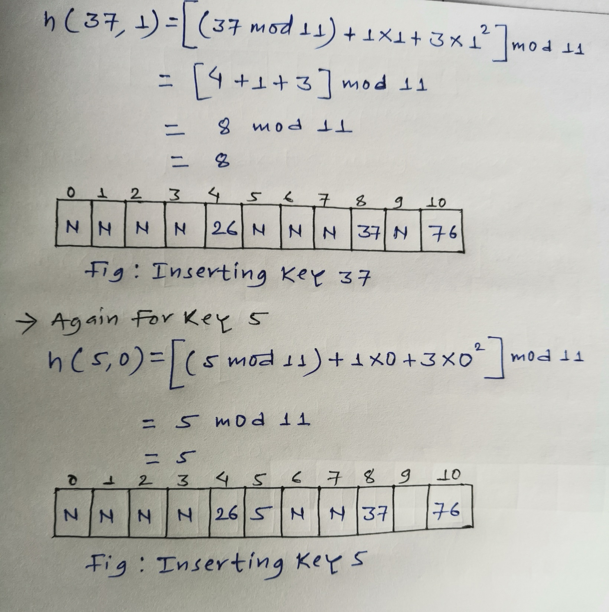

Slide 72
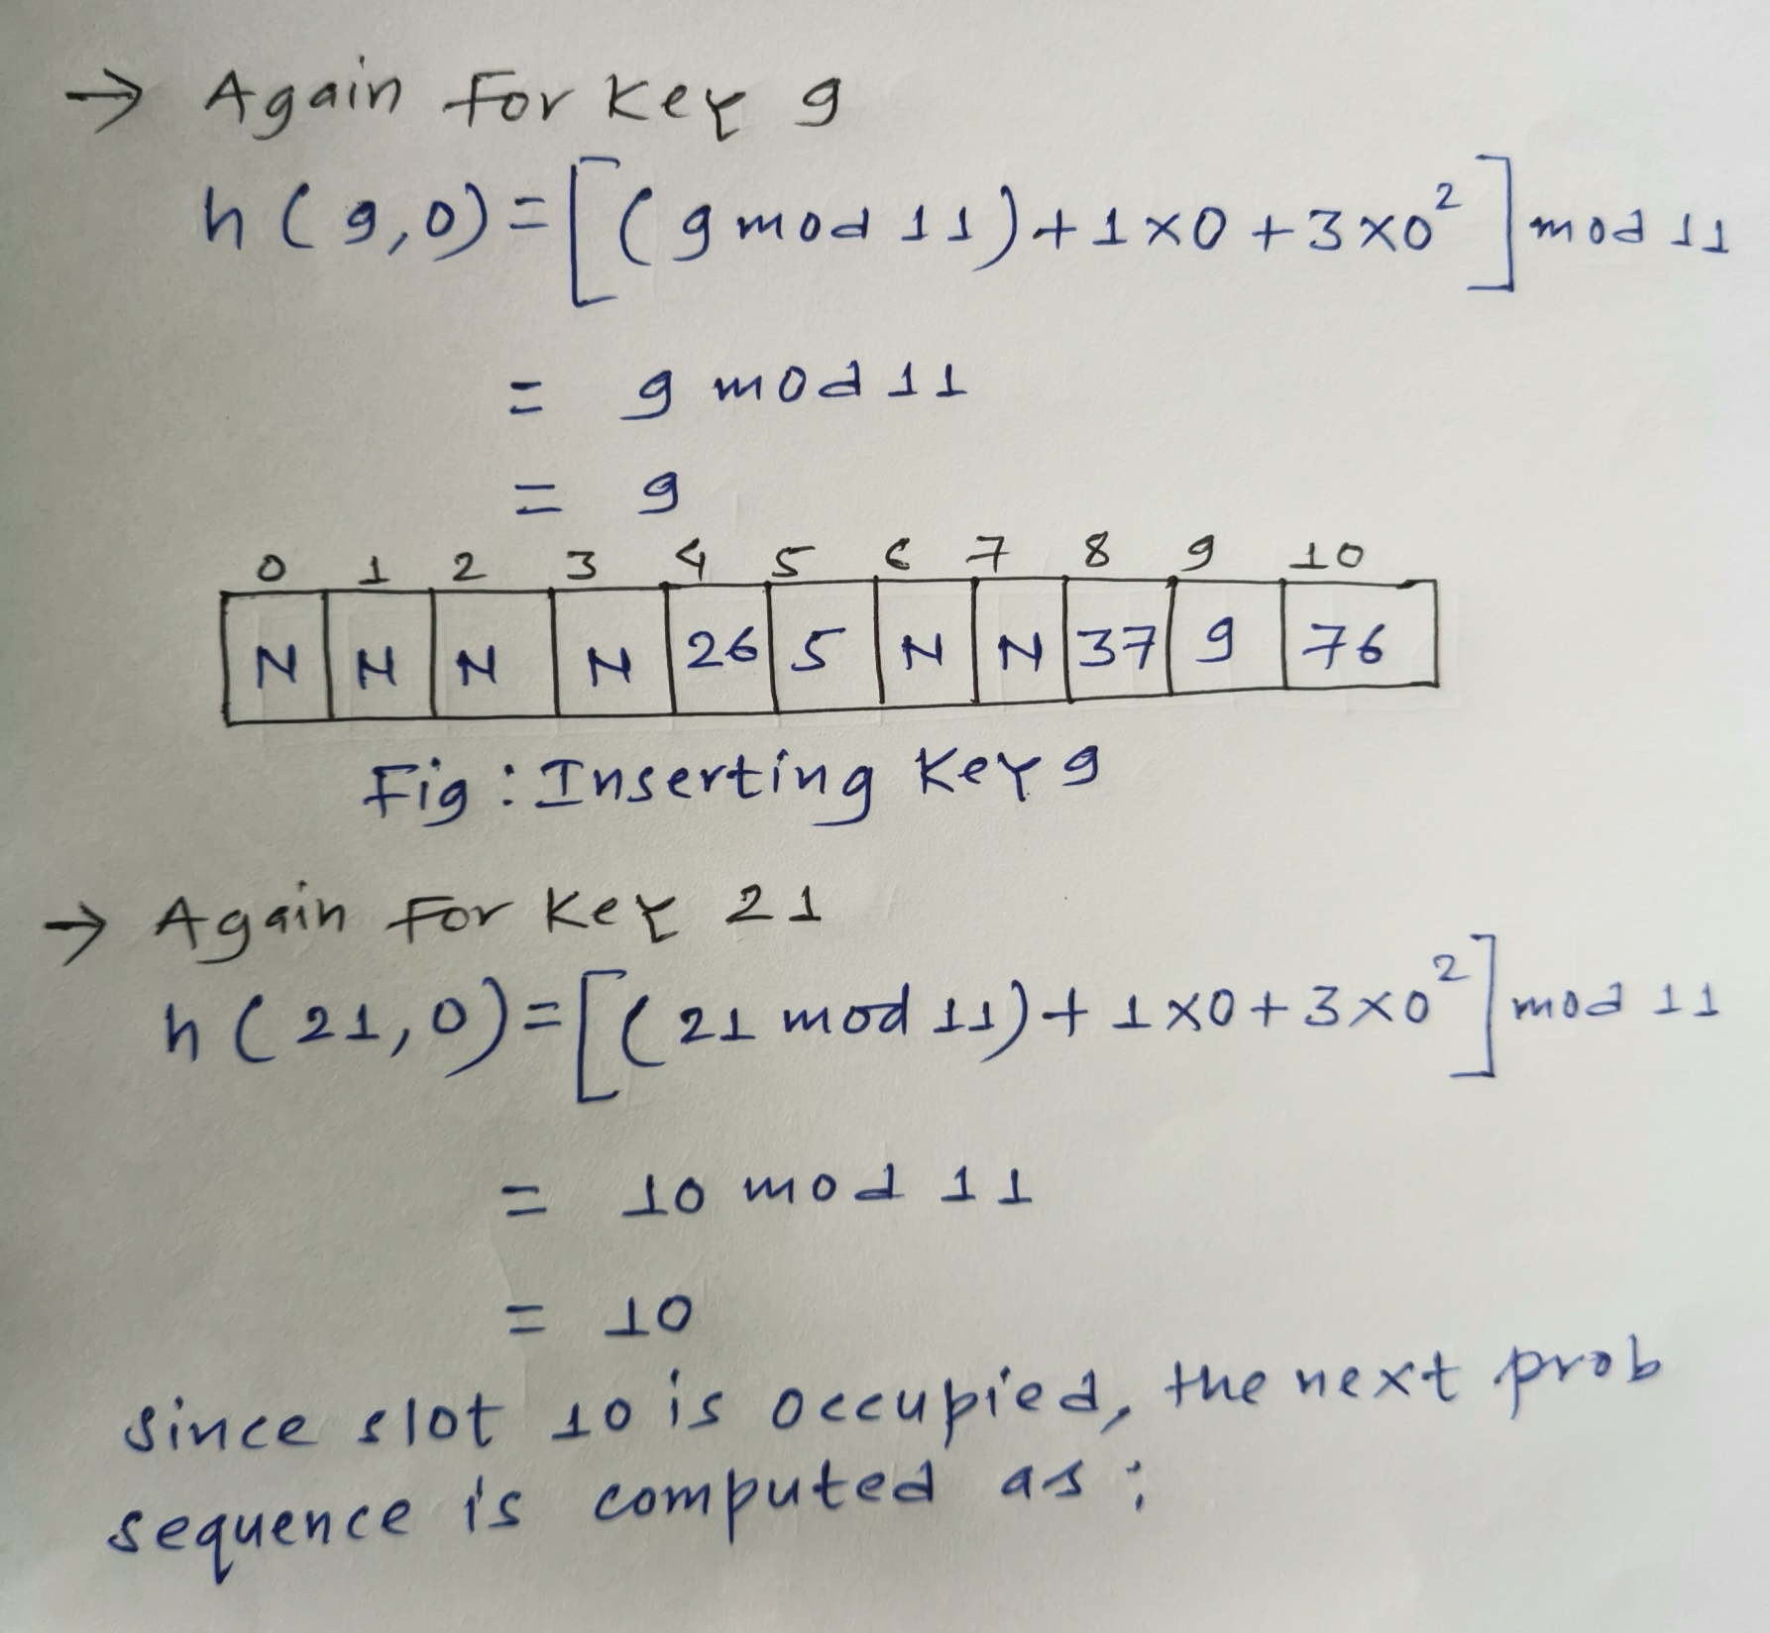

Slide 73
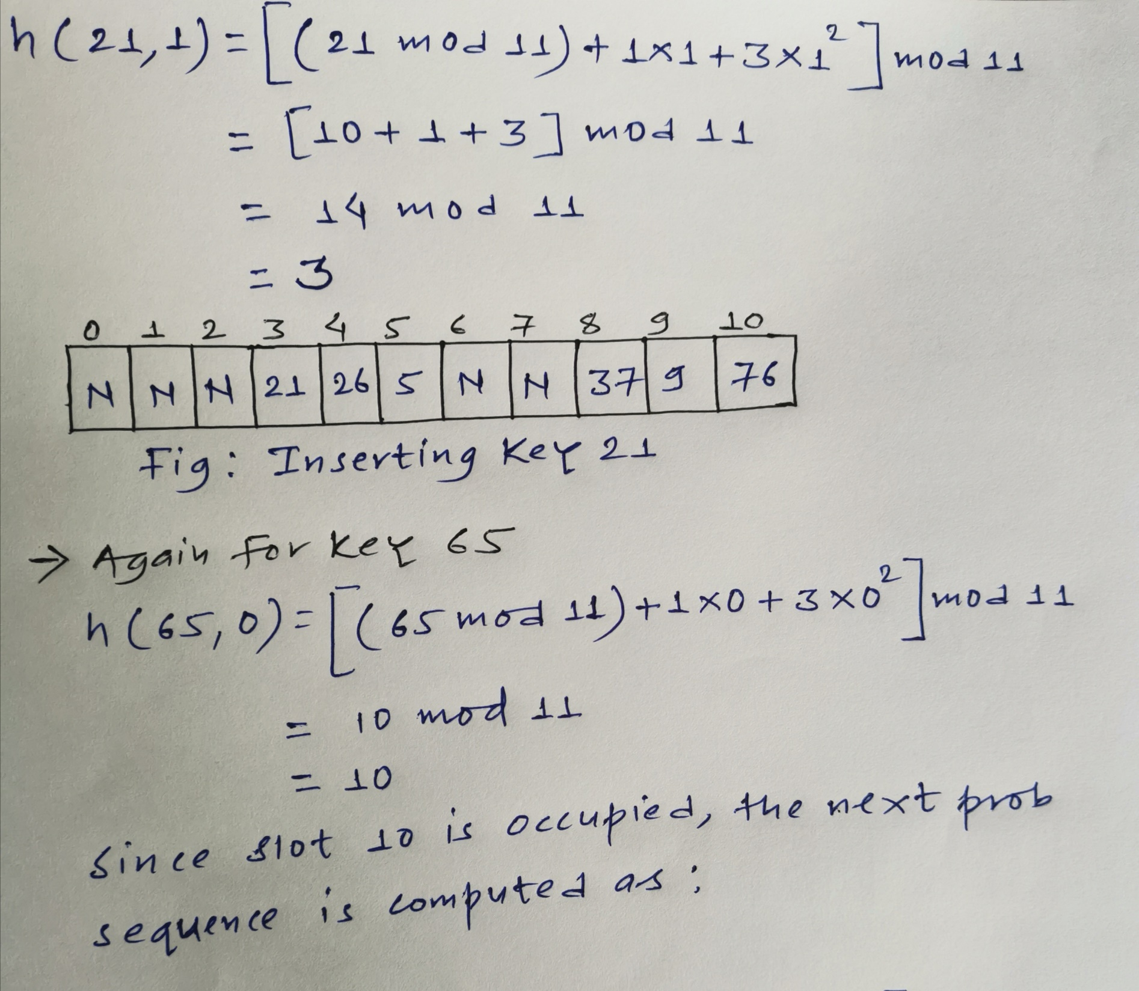

Slide 74
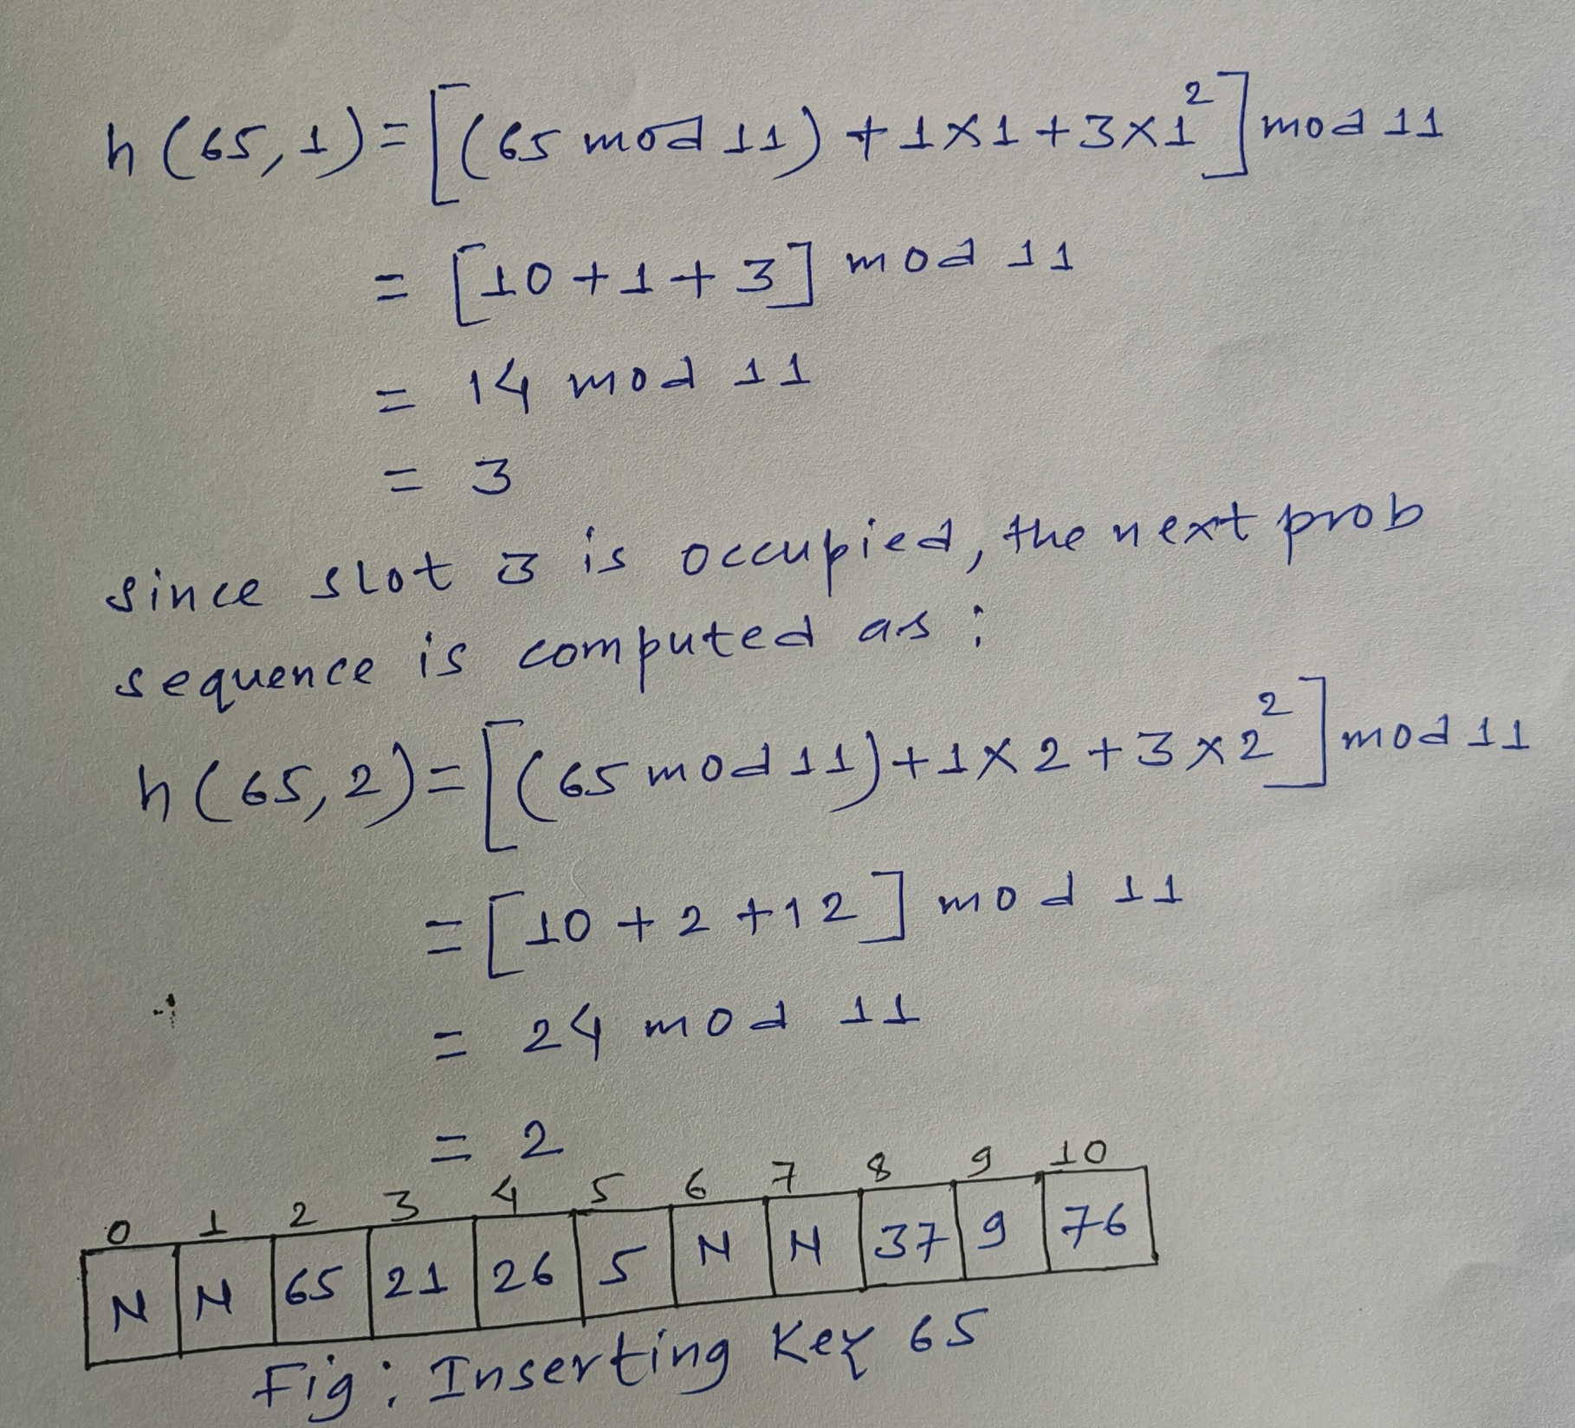

Slide 75
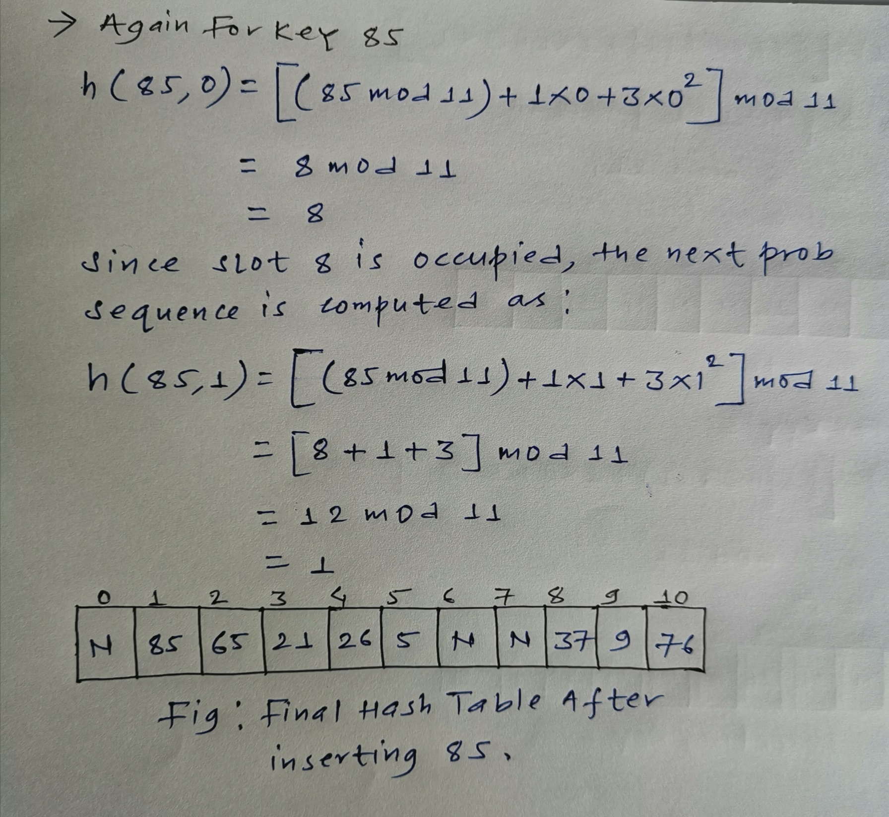

Slide 76
Do this question by yourself.
Q2. Let us consider a hash function h’(k)=k mod m where m=7 and sequence of keys as 50, 700, 76, 85, 92, 73, 101. Now store the keys using quadratic probing method where, c1=1 and c2=3 respectively.
Solution:

